Slide 1

Civic Hospital Neighbourhood Association
Spring Information Meeting
June 6, 2023
www.chnaottawa.ca

Slide 2
CHNA Agenda
Review of Agenda and General Remarks: Karen Wright, President
Environment: Laurel McIvor
Membership: Susan Chell
New Ottawa Hospital Advisory Council: Alison Taylor
Transportation –Sherwood NTC & Hospital NCD: Luanne Calcutt
History and Heritage: Matt Lemay
Planning and Development: Karen Wright for Linda Niksic
1081 Carling: Nicholas Eisner
Home Security and Fraud Prevention: Shane Quinn
CHNA Openings: Karen Wright
Kitchissippi Ward Update/Q&A : Councillor Jeff Leiper
Adjournment

Slide 3
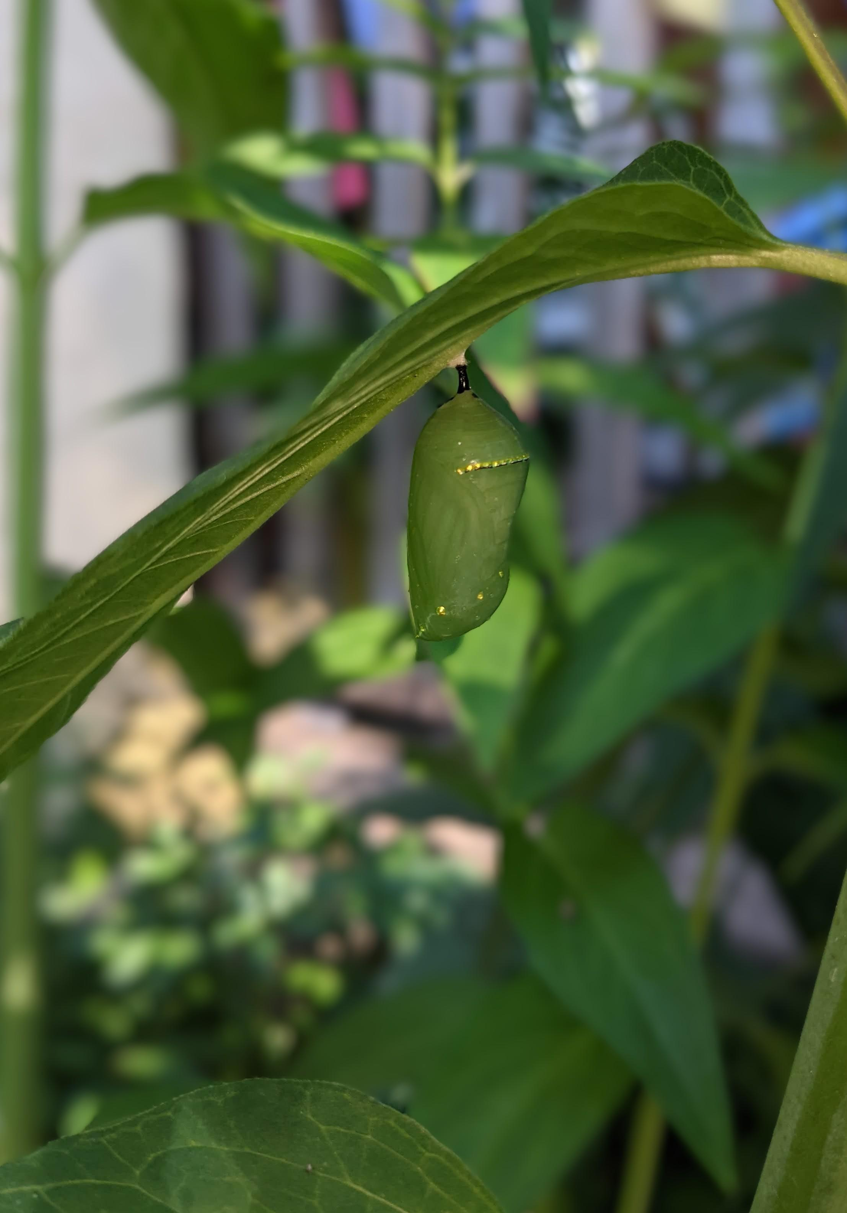
Environment – Laurel McIvor
Native Plant Garden
National Forest week September 18-24th
  Tree sidewalk I.D
  Tree Activities – Sept 23
Community Climate Resiliency

Slide 4
Community Climate Resiliency
Loss of biodiversity
Support native plants & wildlife
High rainfall
Increase porous surfaces
Heat waves
Plant and nurture shade trees
Extreme Weather
Apathy or despair
Know your neighbours
Stay informed & share successes

Slide 5
Membership
– Susan Chell

Slide 6


Slide 7
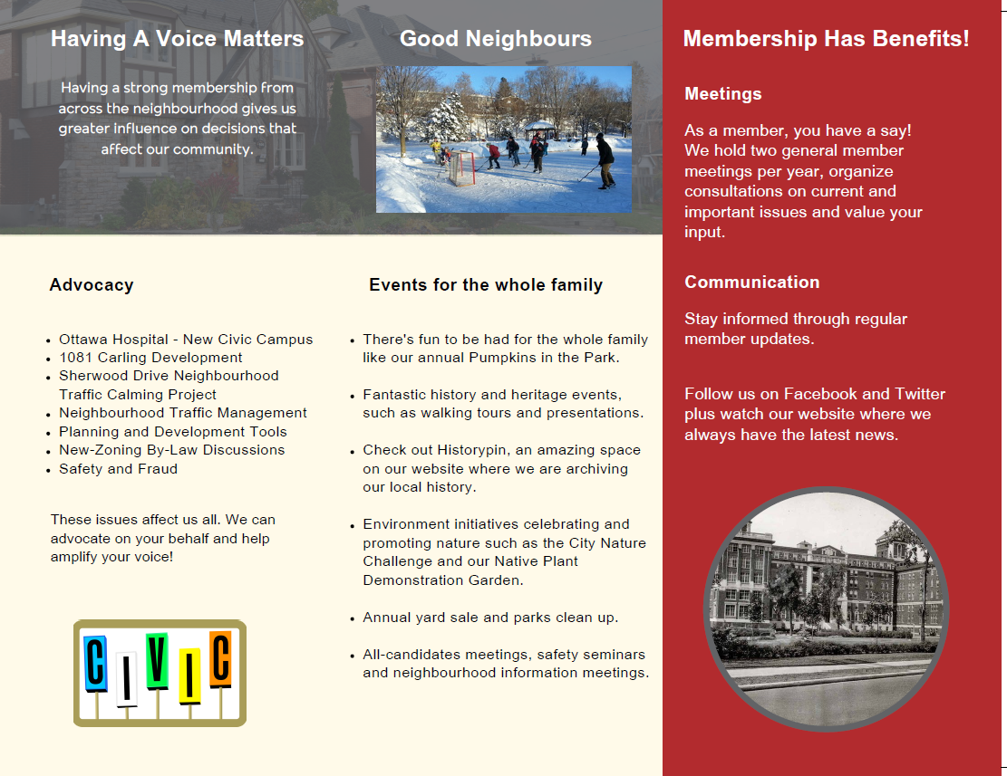

Slide 8
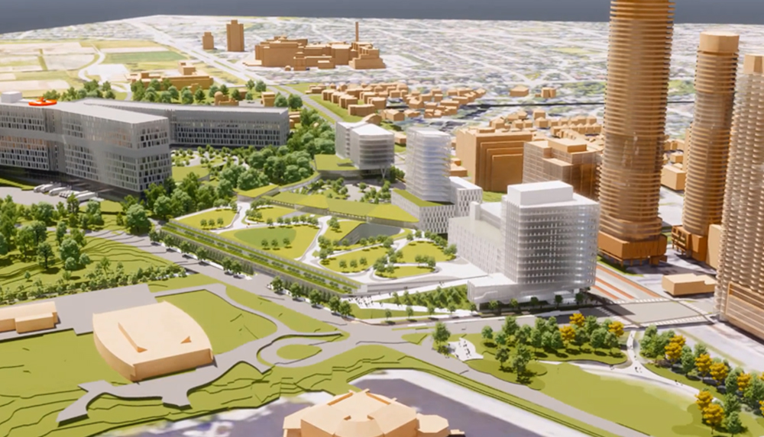
New Ottawa Hospital Advisory Council
Alison Taylor

Slide 9
Transportation
– Luanne Calcutt

Slide 10
CHNA Transportation Committee
Vincent Beswick-Escanlar
Christina Cameron
Ian Macredie
Jeff Hurtig
Tanis Halpape
Keith Hobbs
Mark Scrivens
Anish Mehra
Wendy Jarath

Slide 11
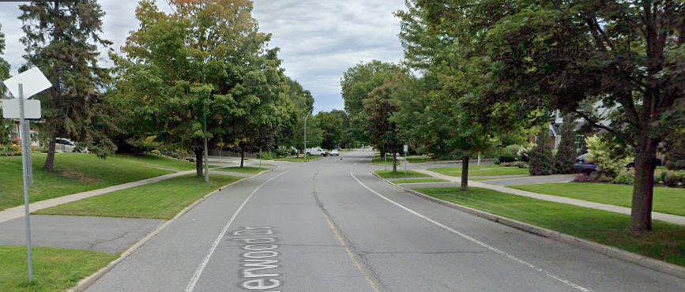
Sherwood Neighbourhood Traffic Calming
Luanne Calcutt

Slide 12
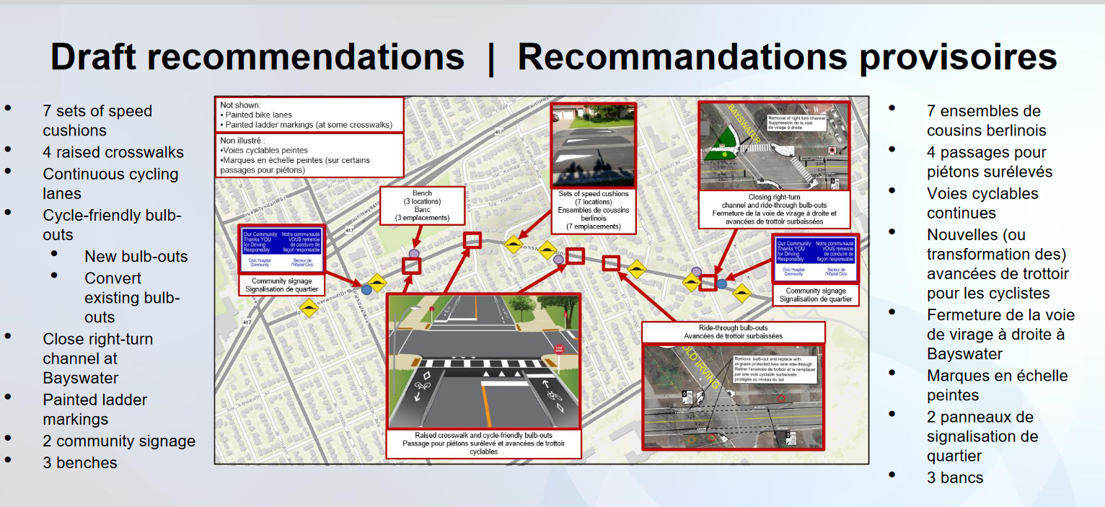

Slide 13
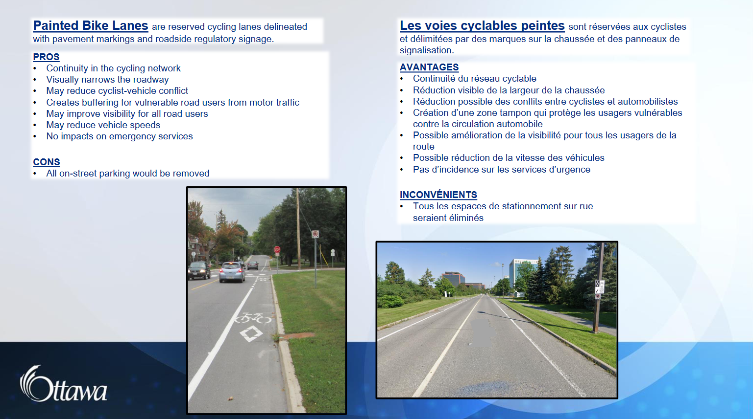

Slide 14
New Campus Development (NCD) Transportation Strategies
CHNA Response
- Luanne Calcutt
Neighbourhood Traffic Management Strategy
Transportation Demand Management Strategy
Off Site Parking Strategy
Transportation Monitoring Strategy
Notes:
Hospital NCD & Sherwood NTC

Slide 15
1. Neighbourhood Traffic Management (NTMS)
CHNA challenges several assumptions contained in this strategy. It is our position that:
Reduction in auto share targets will not be met, from current 85% to 50% to 35%.
Parkdale should not be identified as a Tier 2: Low to Moderate Impacted rather than Tier I –Highly Impacted, simply because it is an arterial road.
The traffic burden on Parkdale will not be reduced once NCD opens.
Cut-through traffic on Sherwood will not be reduced; Sherwood NTC addresses traffic speed not the impact of increased traffic volume.
Traffic calming alone will not reduce speed and volume on ‘vulnerable’ streets (11 segments have been identified as ‘vulnerable’ based on speed, volume data).
CHNA requests conditions on the site plan and/or other measures to address resulting traffic infiltration.

Slide 16
2. Transportation Demand Management Strategy (TDM)
Transportation demand can only be managed successfully if it is based on sound modal share statistics.
NCD statistics are either of questionable quality or missing altogether.
Therefore, transportation demand management techniques, when misdirected by faulty/statistics, cannot meet their stated goals.
Accurate and complete modal share data must be obtained through robust surveys of staff, visitors, volunteers and patients. To date, this has not been the case.
LRT -CHNA requests information on what will be done concerning the Dow’s Lake Station extension. A pedestrian overpass is recommended. The use of an at-grade pedestrian crossing of Carling Avenue adds inconvenience when using the existing LRT station and likely reduce utilization.

Slide 17
3. Off Site Parking Strategy (OPS)
10,847 parking tickets issued since January 2020, Holland Avenue -Fairmont Avenue -417 -Carling (approx. 300 on street parking spaces) –likely an underestimation.
NCD -potentially impacted streets, according to the 15-minute walking distance assumption (i.e. 900 m radius) are bounded by MacFarlane Avenue, Trillium Line, Highway 417, and Carling Avenue.
Several streets are highly at risk for parking spillover as they fall within the 900m radius of both the existing Civic and NCD although further streets may also be susceptible.
Off-site parking with ‘lines of communication and collaboration with residents remain open, etc.’ is a highly ineffective means of addressing problems.

Slide 19
4. Transportation Monitoring Strategy (TMS)
The Terms of Reference for the TMS states that TOH will make decisions on how to mitigate the transportation related impacts caused by the New Campus.
CHNA argues that the since the decision-making authority for any address rests solely with TOH, this could create a potential conflict of interest.
Since there is no oversight authority beyond that of the TOH, a Transportation Monitoring Strategy could be vulnerable to a lack of funding.
TOH and the City need to ‘get things right’ from the onset rather than correcting after the fact.

Slide 20
History and Heritage
– Matt Lemay

Slide 21
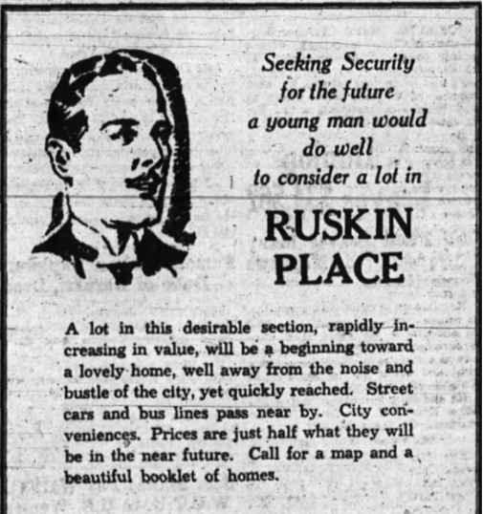
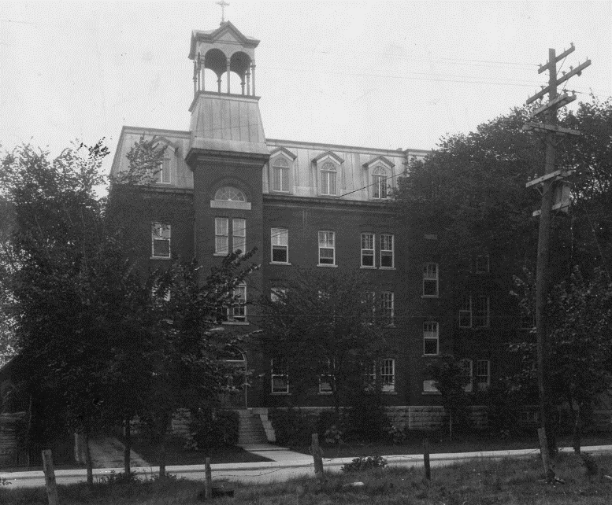
History and Heritage
- Matt Lemay
New Heritage Ottawa neighbourhood walking tour featuring houses west of Parkdale in the area previously known as Ruskin Place – July 23rd 2PM
Fall in-person history evening planned (shortly after the fall AGM)
Virtual house history workshop this winter
Website updates including past presentations and new additions to Historypin

Slide 22
2023 CHNA Planning and Development Tool Kit Updated
Karen Wright for Linda Niksic
Updated April 2023 - WORK IN PROGRESS
1. CHNA Planning and Development Committee’s Guiding Principles
2. Applying Guiding Principles to Proposed Developments with Examples
3. City of Ottawa New Official Plan
4. City of Ottawa Zoning By-law Review
5. Intensification Plans
Notes:
The CHNA Planning and Development Tool Kit is designed to provide an overview of the guiding principles of the CHNA Planning and Development Committee followed by examples of proposed developments and showing how we try to apply guiding principles, as well as an overview of City of Ottawa Official Plan, Zoning information and other resources and links to guide you in planning and development processes. This is a draft document that is a work in progress. Originally posted May 2021, updated April 2023.

Slide 23
Current Plans Affecting our Neighbourhood
City of Ottawa Planning and Development Process
Interesting Planning and Development Measures
Key Links to Resources
ANNEX A (Pages 13-16):
Near Future and Ongoing Focus: Four Different Developments Impacting Our Community, including chart overview of CHNA ACTIONS
ANNEX B (Page 17-18):
Impact of Surrounding Developments on Preston Street and Carling Avenue

Slide 24
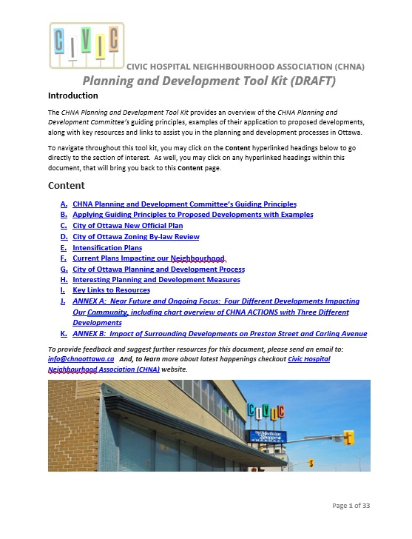

Slide 25
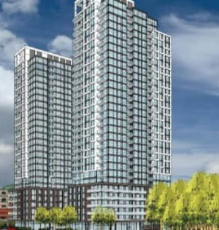
1081 Carling
Subcommittee
Co-chair:
Nicholas Eisner
CHNA Executive Liaison:
Luanne Calcutt

Slide 26
Issue
Taggart applied (2021) to build two large residential towers at 1081 Carling Ave.
Currently zoned for 9 stories; proposed rezoning would allow two towers of 16 and 27 stories.
Towers would cast shadows on adjacent low-rise residential area and on parts of the Central Experimental Farm (CEF).
Height and scale would not permit transition through "sensitive integration of low-rise, mid-rise and high-rise buildings" (per Ottawa's New Official Plan).
Would add 340 resident vehicles as well as service vehicles, with access on Hamilton Avenue.
CHNA concerned that this would set a precedent for development along southern boundary; retained legal counsel.
Initial opposition by Councillor Leiper.

Slide 27
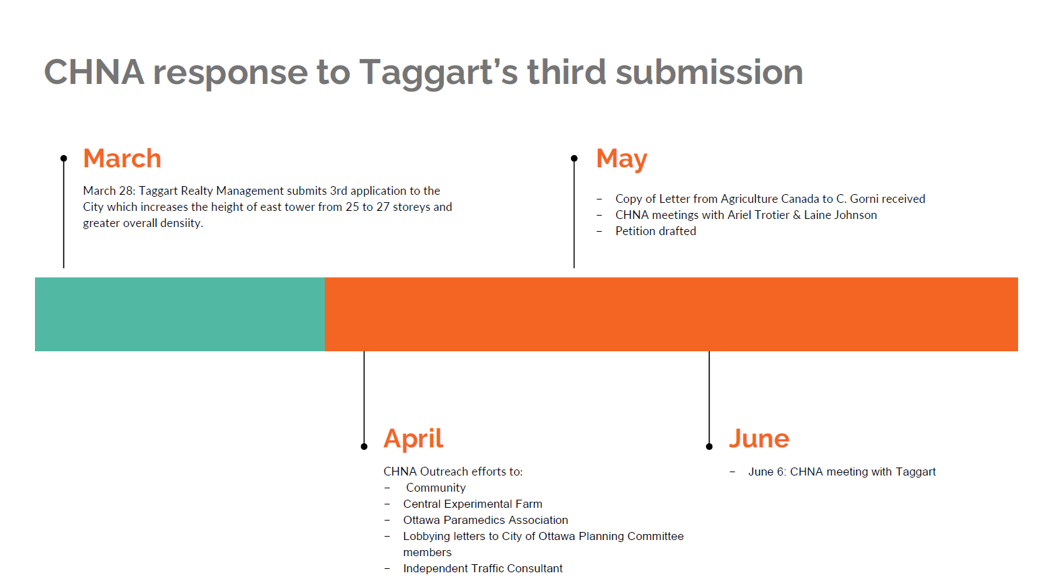

Slide 28
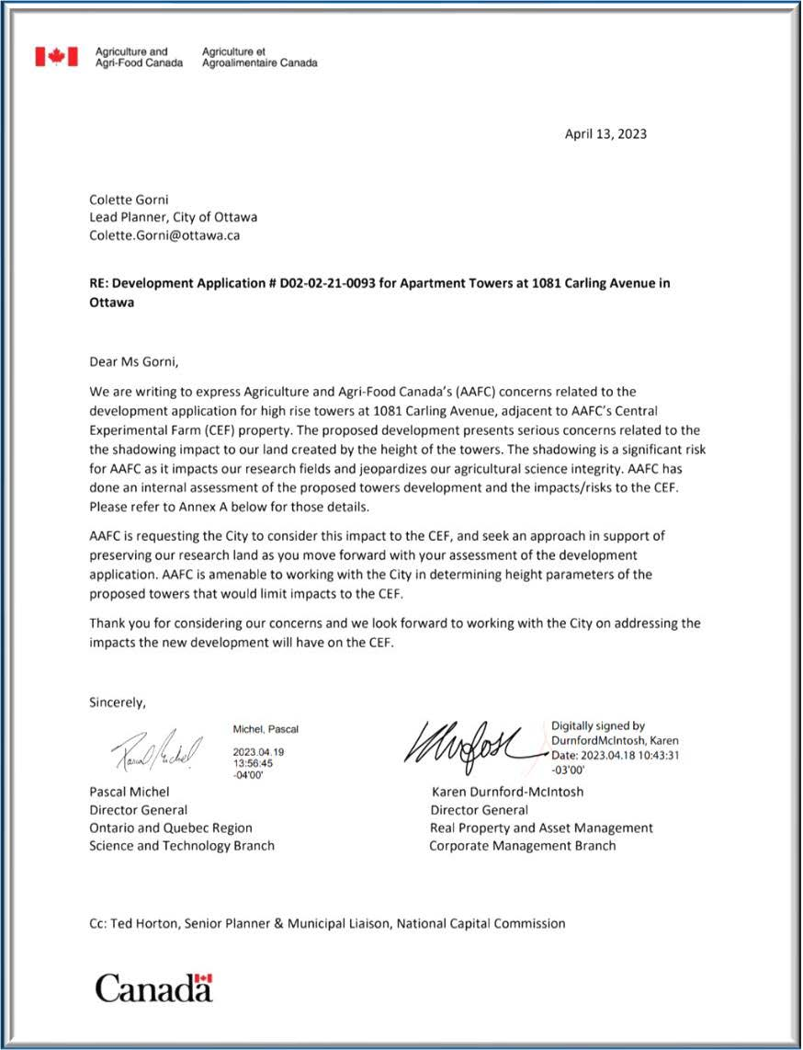
Shadow Impacts on the Central Experimental Farm
Vital Central Experimental Farm research examining the effects of climate change and drought stress on crop production and yield would be compromised by the increased shadows created by height of the proposed development.
A Letter from the Department of Agriculture was submitted to City planners on April 13.
Expresses serious concern about the negative impact of the proposed development.

Slide 29
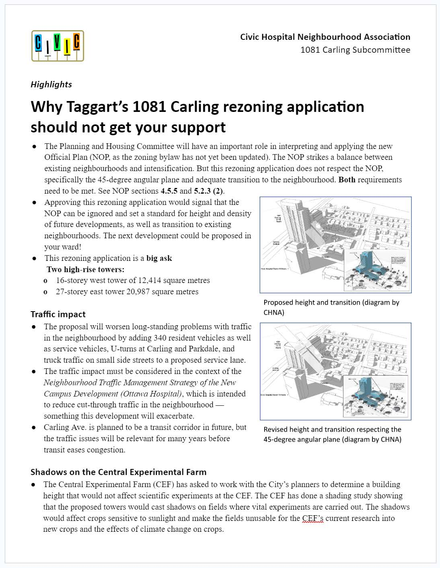
CHNA Lobbying and Outreach
Flyer drops, emails, webinar resulting in numerous submissions to the City;18 resident submissions to planner and to J. Leiper opposing the latest application
Lobbying emails and briefing notes sent to Planning Committee members regarding lack of alignment with NOP, traffic impacts, shadow effects on the CEF; subsequent meetings with Councillors Ariel Troster, Laine Johnson
Exchange with Ottawa Paramedics Association regarding circuitous emergency vehicle traffic routes from site location to hospital
June 6th meeting with Taggart

Slide 30
Home Security and Fraud Prevention
– Shane Quinn

Slide 31
Website
Mandate
Crime Prevention Resources
Incident reporting
Notes:
Home Safety
Home Security Inspections
OPS resources for Crime Prevention
How to report incidents

Slide 32
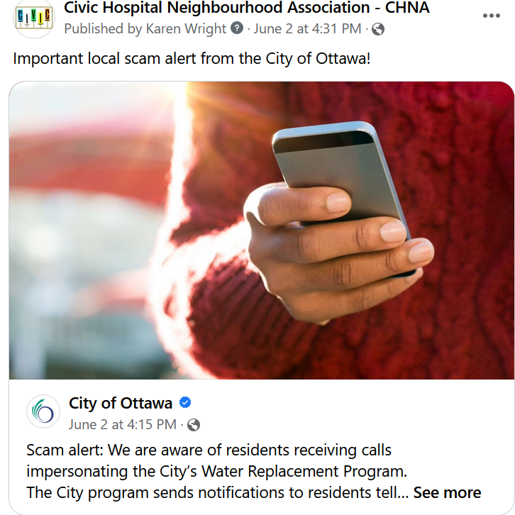
Social Media
Notes:
Watch our Social Media for emerging scams!

Slide 33
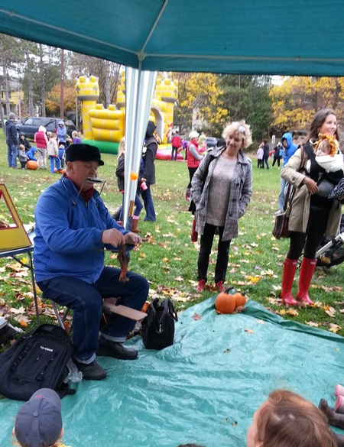
2023 CHNA Openings
Karen Wright
Notes:
Communications Chair, Vice President, President in Training, Fundraising, Events.

Slide 34
2023 CHNA Openings
OPEN:
Communications
President - 2024
Vice President
Notes:
Communications Chair, Vice President, President in Training, Fundraising, Events

Slide 35
2023 CHNA Openings
Additional Opportunities
Subcommittee Leads
Fundraising and Sponsorship
Special Events

Slide 36
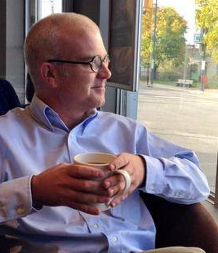
Kitchissippi Updates Q&A
Councillor Jeff Leiper

Slide 37
ADJOURNMENT

