Slide 1
Civic Hospital Neighbourhood Association Annual General Meeting
Nov. 03, 2015
www.chnaottawa.ca

Slide 2
CHNA Agenda
7:00 pm Review of Agenda and General Remarks: Karen Wright, President CHNA
7:05 pm Guest Speaker: Marion Fraser CFO, VP Finance and Admin- Heart Institute
UOHI Expansion Update
Cyclotron/Radioisotope Safety Program
7:20 pm Finance Report: Julie Westall, Treasurer
7:25 pm History and Heritage Update: Matt Lemay and Chris Uchiyama
History Pin
Oral History Project
7:40 pm Break
Stretch and Update your Membership
7:45 pm Election Time: 2016 CHNA Board
7:55 pm Constitution Explained: Peter Eady, Vice President
8:05 pm Kitchissippi Update – Councillor Leiper
8:20 pm Q&A
8:30 Adjournment

Slide 3
Heart Institute Update – Marion Fraser CFO, VP Finance and Admin

Slide 4
CHNA Agenda
7:00 pm Review of Agenda and General Remarks: Karen Wright, President CHNA
7:05 pm Guest Speaker: Marion Fraser CFO, VP Finance and Admin- Heart Institute
HI Expansion Update
Cyclotron/Radioisotope Safety Program
7:20 pm Finance Report: Julie Westall, Treasurer
7:25 pm History and Heritage Update:
History Pin- Matt Lemay
Oral History Project – Chris Uchiyama
7:40 pm Break
Stretch and Update your Membership
7:45 pm Election Time: 2016 CHNA Board
7:55 pm Constitution Explained: Peter Eady, Vice President
8:05 pm Kitchissippi Update – Councillor Leiper
8:20 pm Q&A
8:30 Adjournment

Slide 5
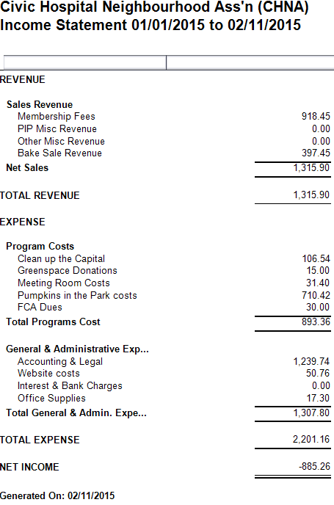
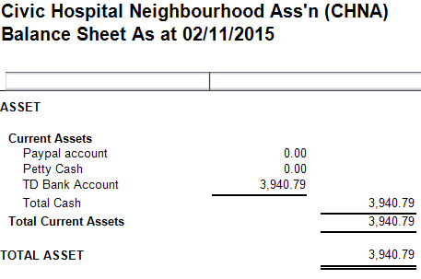
Finances
Dues received for 2015 & 2015/2016 Years
Bouncy castle/tug of rope, entertainment, coffee, supplies
$416.90 – Incorporation Costs
$822.84 – Final Ruskin bill

Slide 6
CHNA Agenda
7:00 pm Review of Agenda and General Remarks: Karen Wright, President CHNA
7:05 pm Guest Speaker: Marion Fraser CFO, VP Finance and Admin- Heart Institute
HI Expansion Update
Cyclotron/Radioisotope Safety Program
7:20 pm Finance Report: Julie Westall, Treasurer
7:25 pm History and Heritage Update:
History Pin- Matt Lemay
Oral History Project – Chris Uchiyama
7:40 pm Break
Stretch and Update your Membership
7:45 pm Election Time: 2016 CHNA Board
7:55 pm Constitution Explained: Peter Eady, Vice President
8:05 pm Kitchissippi Update – Councillor Leiper
8:20 pm Q&A
8:30 Adjournment

Slide 7
Oral History Project – Chris Uchiyama
“the collection and study of historical information using sound recordings of interviews with people having personal knowledge of past events”
You may not realise it, but your stories are an important and interesting part of the history of our community

Slide 8
CHNA Agenda
7:00 pm Review of Agenda and General Remarks: Karen Wright, President CHNA
7:05 pm Guest Speaker: Marion Fraser CFO, VP Finance and Admin- Heart Institute
HI Expansion Update
Cyclotron/Radioisotope Safety Program
7:20 pm Finance Report: Julie Westall, Treasurer
7:25 pm History and Heritage Update:
History Pin- Matt Lemay
Oral History Project – Chris Uchiyama
7:40 pm Break
Stretch and Update your Membership
7:45 pm Election Time: 2016 CHNA Board
7:55 pm Constitution Explained: Peter Eady, Vice President
8:05 pm Kitchissippi Update – Councillor Leiper
8:20 pm Q&A
8:30 Adjournment

Slide 9
2016 CHNA Board Election
Roles and Nominees (*returning)
President – Karen Wright *
Vice President – Peter Eady*
Treasurer – Julie Westall*
Secretary – Katherine Steinhoff *
Development – Kathy Kennedy*
Safety – Shane Quinn*
Transportation - Luanne Calcutt*
Communications - Alyson Queen*
Fundraising and Membership – Shelley Mullins*

Slide 10
CHNA Agenda
7:00 pm Review of Agenda and General Remarks: Karen Wright, President CHNA
7:05 pm Guest Speaker: Marion Fraser CFO, VP Finance and Admin- Heart Institute
HI Expansion Update
Cyclotron/Radioisotope Safety Program
7:20 pm Finance Report: Julie Westall, Treasurer
7:25 pm History and Heritage Update:
History Pin- Matt Lemay
Oral History Project – Chris Uchiyama
7:40 pm Break
Stretch and Update your Membership
7:45 pm Election Time: 2016 CHNA Board
7:55 pm Constitution Explained: Peter Eady, Vice President
8:05 pm Kitchissippi Update – Councillor Leiper
8:20 pm Q&A
8:30 Adjournment

Slide 11
Constitution Explained – Peter Eady, VP

Slide 12
CHNA Agenda
7:00 pm Review of Agenda and General Remarks: Karen Wright, President CHNA
7:05 pm Guest Speaker: Marion Fraser CFO, VP Finance and Admin- Heart Institute
HI Expansion Update
Cyclotron/Radioisotope Safety Program
7:20 pm Finance Report: Julie Westall, Treasurer
7:25 pm History and Heritage Update:
History Pin- Matt Lemay
Oral History Project – Chris Uchiyama
7:40 pm Break
Stretch and Update your Membership
7:45 pm Election Time: 2016 CHNA Board
7:55 pm Constitution Explained: Peter Eady, Vice President
8:05 pm Kitchissippi Update – Councillor Leiper
8:20 pm Q&A
8:30 Adjournment

Slide 13
Kitchissippi Update – Councillor Jeff Leiper

Slide 14
Open Discussion /Q&A

Slide 15
CHNA Agenda
7:00 pm Review of Agenda and General Remarks: Karen Wright, President CHNA
7:05 pm Guest Speaker: Marion Fraser CFO, VP Finance and Admin- Heart Institute
HI Expansion Update
Cyclotron/Radioisotope Safety Program
7:20 pm Finance Report: Julie Westall, Treasurer
7:25 pm History and Heritage Update:
History Pin- Matt Lemay
Oral History Project – Chris Uchiyama
7:40 pm Break
Stretch and Update your Membership
7:45 pm Election Time: 2016 CHNA Board
7:55 pm Constitution Explained: Peter Eady, Vice President
8:05 pm Kitchissippi Update – Councillor Leiper
8:20 pm Q&A
8:30 Adjournment

