Slide 1

Civic Hospital Neighbourhood Association Annual General Meeting
Nov. 26, 2014

Slide 2
CHNA
Agenda
7:00 pm Introductions and Annual Review: Karen Wright, President CHNA
  2014 Events, News: Reid Park, TOH Community Advisory Council , Comings and Goings, Civic Announcement, CHNA Election
7:30 pm Key Reports:
  Constitution and Traffic– Peter Eady, Vice President
  Planning and Development – Kathy Kennedy, Development Chair
    2 Motions – George Laing
  Treasurer– Julie Westall, Treasurer
  Safety - Shane Quinn, Safety Chair
7:55 pm Last Call for Candidates and Vote
8:05 pm Councillor Elect Jeff Leiper
8:15 pm Q&A with Councillor Elect Leiper
8:45 pm Adjournment

Slide 3

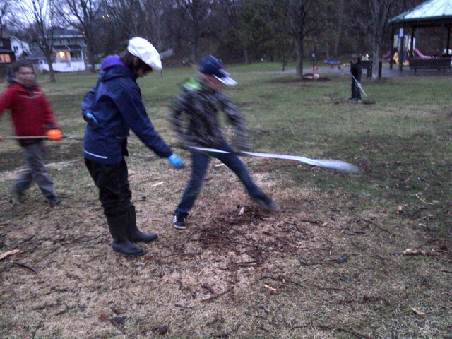

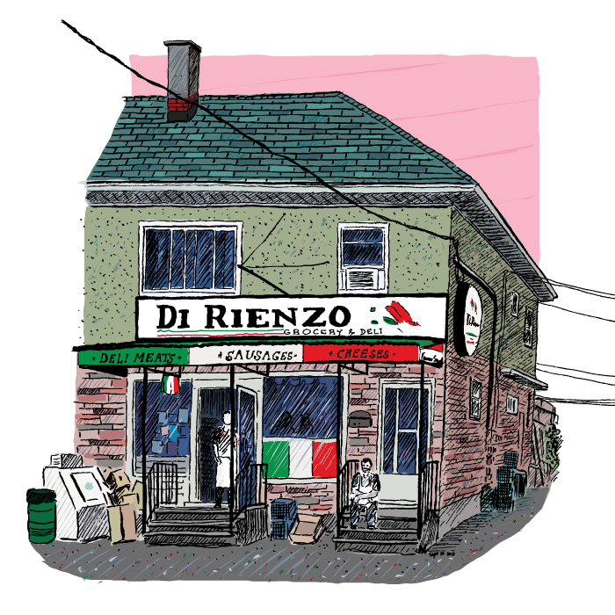
Events May – Karen Wright
Clean up the Capital!

Slide 4
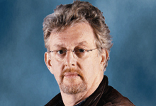
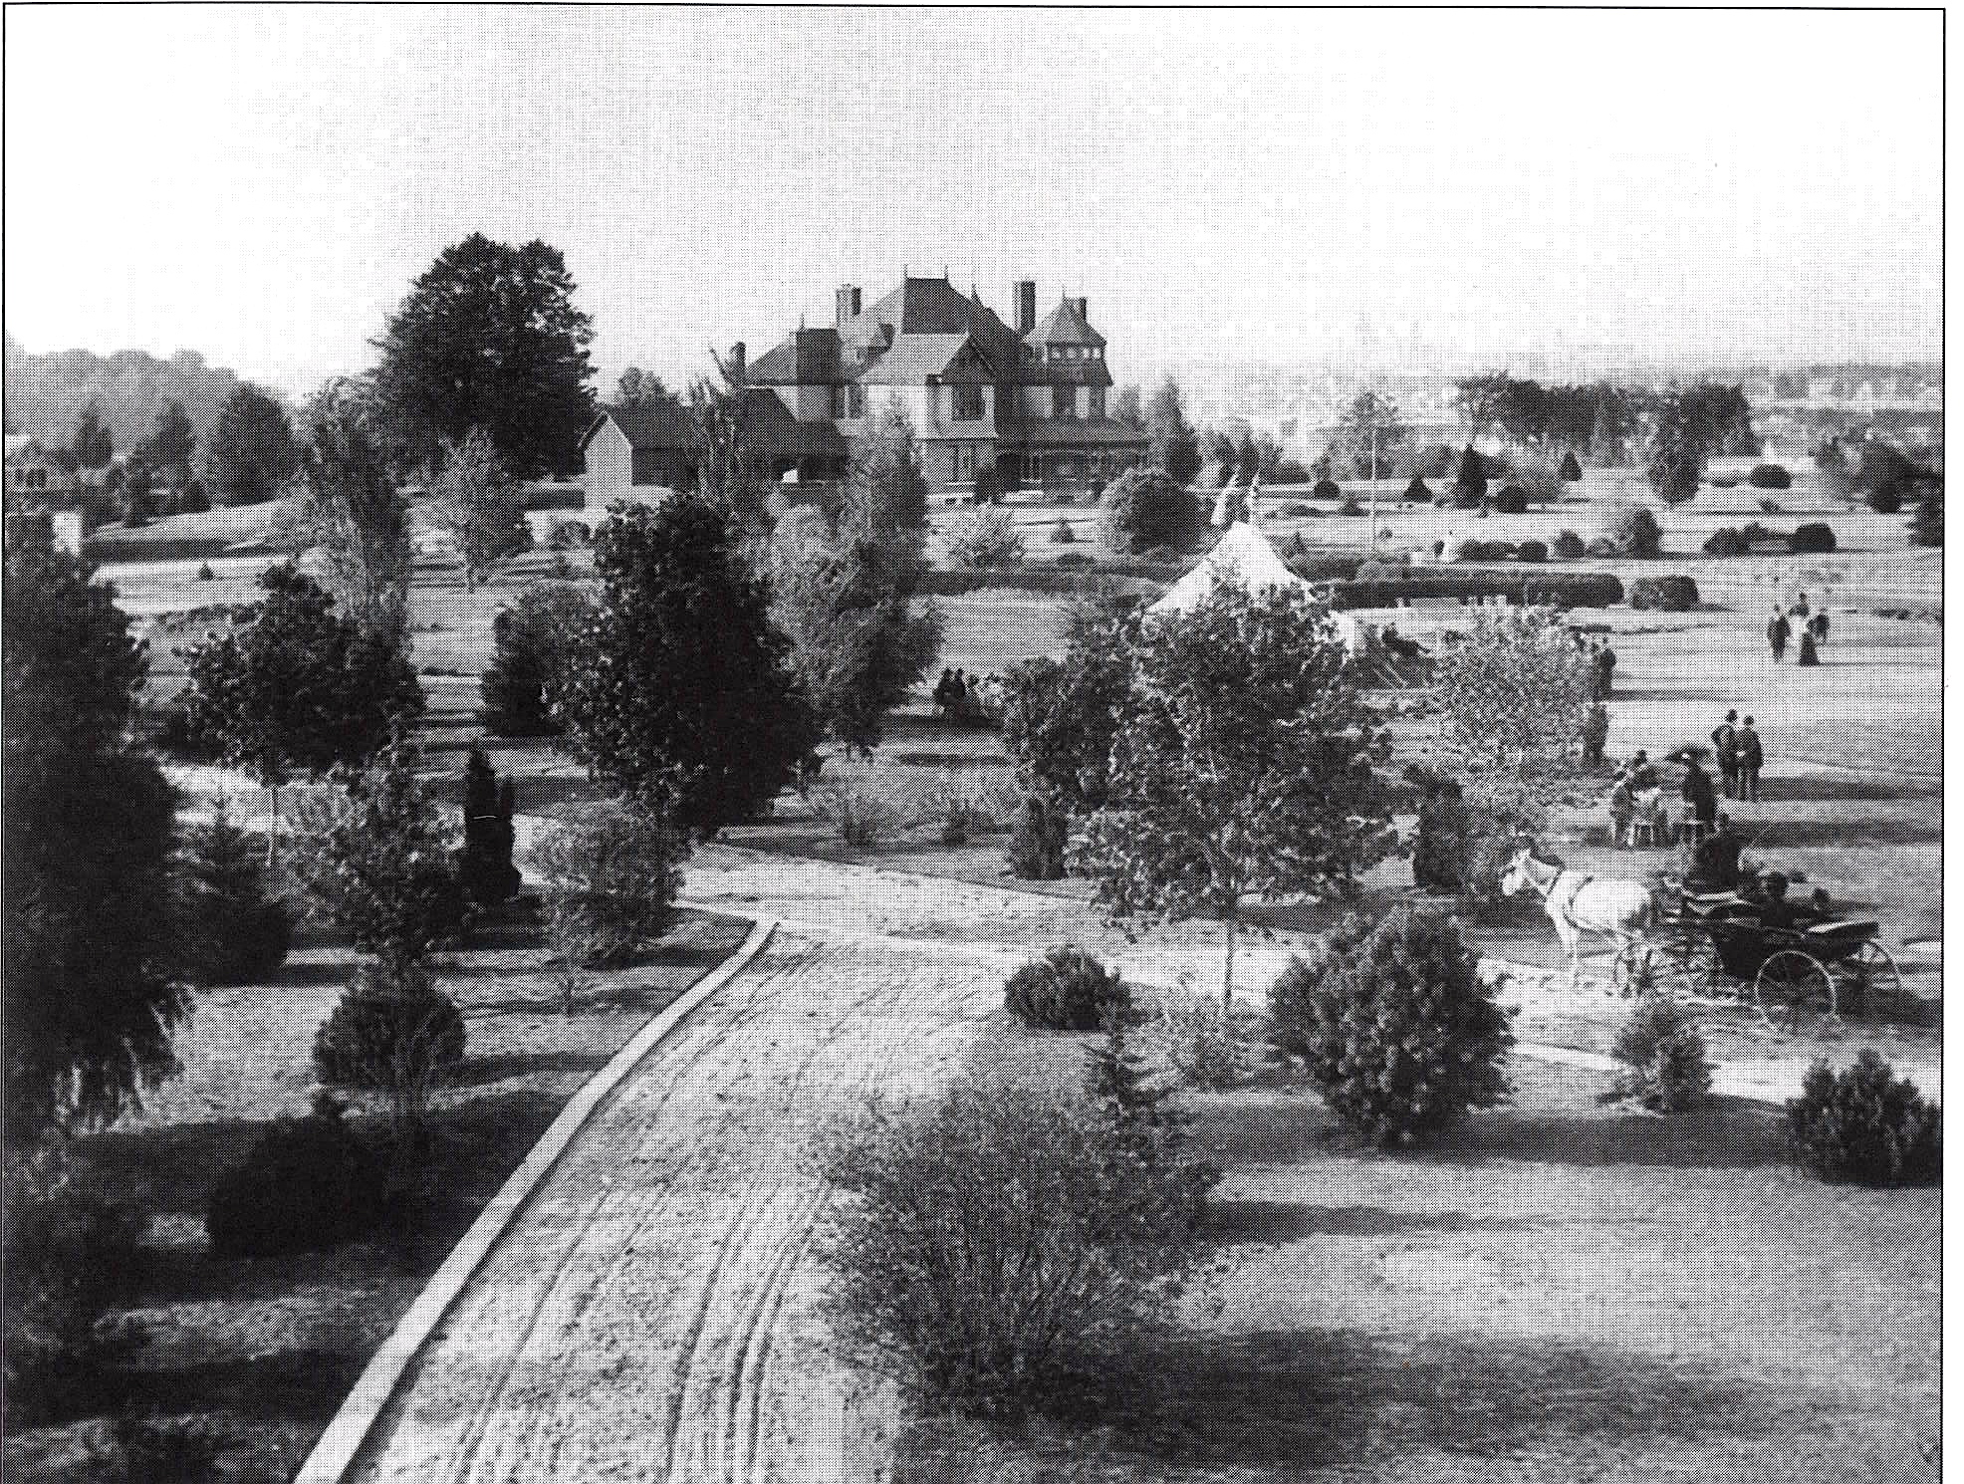
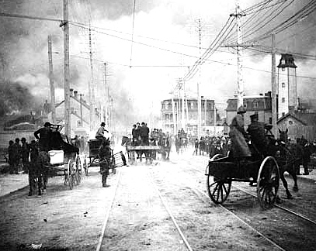

Events May
Phil Jenkins- An Anecdotal History of Ottawa

Slide 5


Events June
Fraud Prevention Seminar
“ABCs of Fraud” by Rotary Club and Ottawa Police Services
Rip-off renovators, Shady salespeople, Bogus Charities, E-mail or phone scams, Con artists and Fraudsters! Don’t be caught napping!

Slide 6
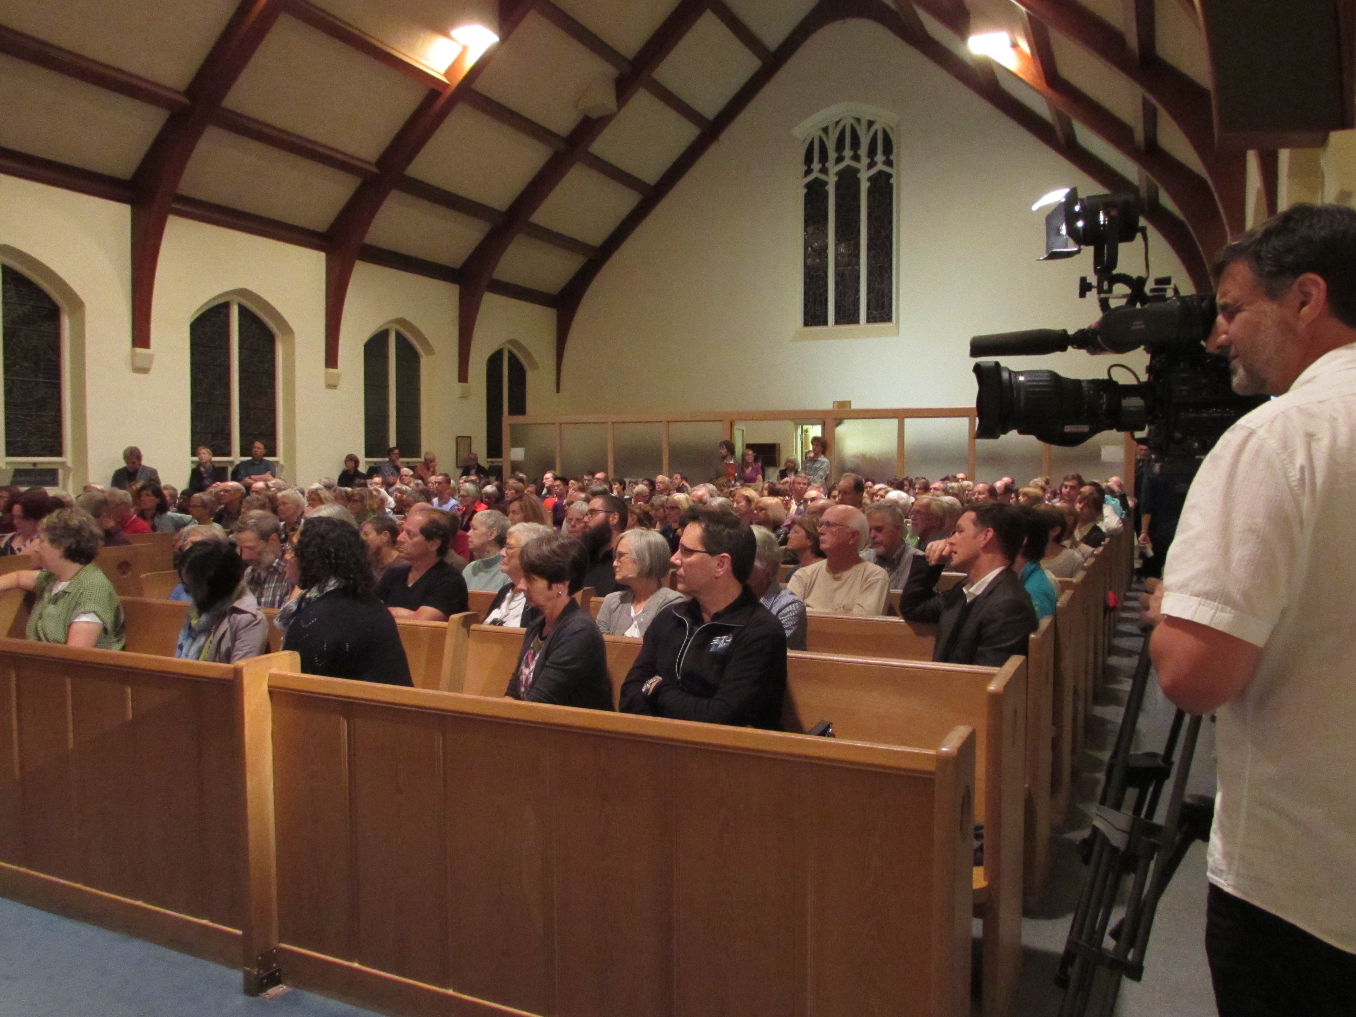
Events October
All Candidates Oct. 1.

Slide 7
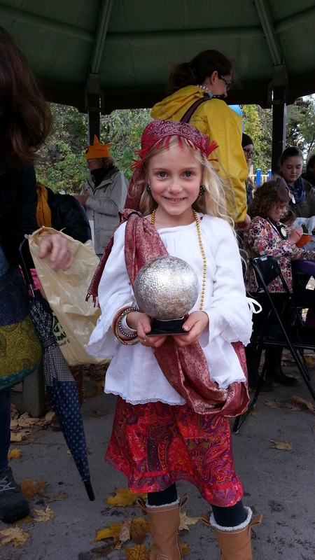
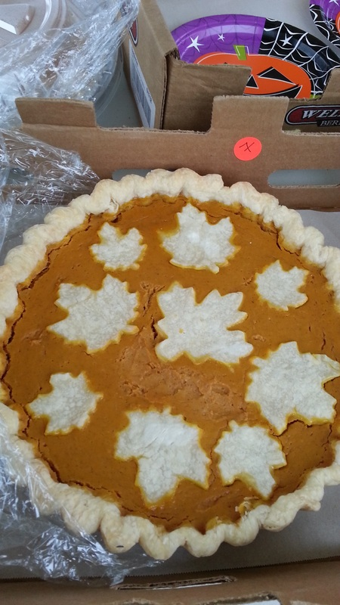
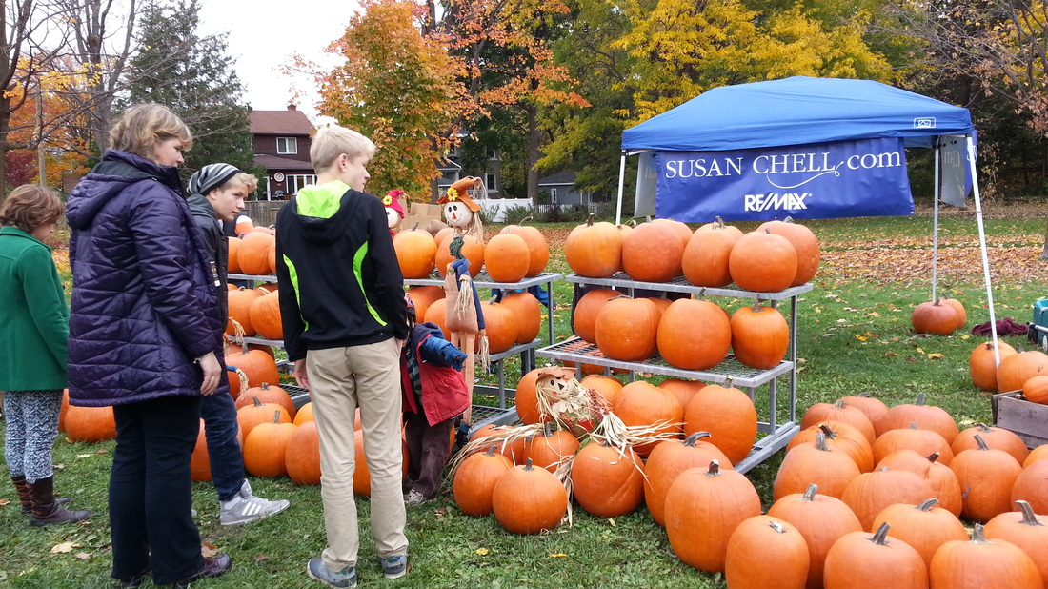
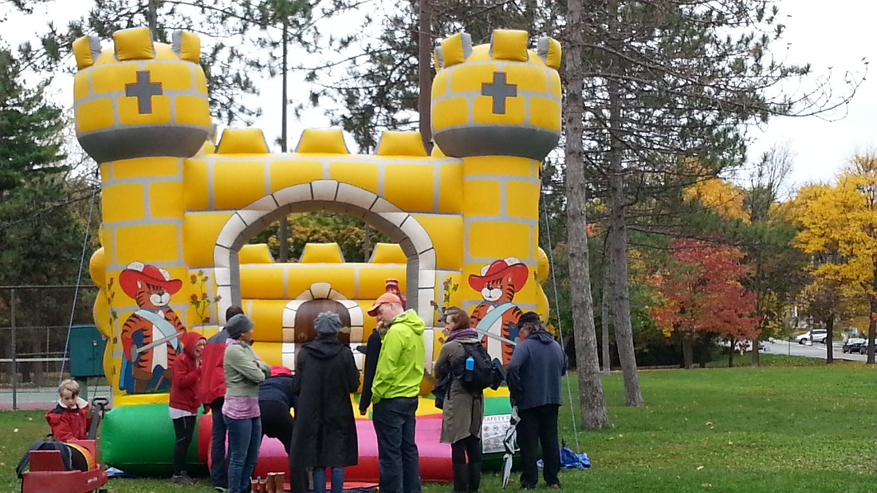
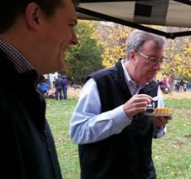
Events October

Slide 8
News: Comings and Goings
  Amanda Farris , CHNA former President
  Officer Andrew Milton
  Officer Dawn Neilly Sylvestre

Slide 9
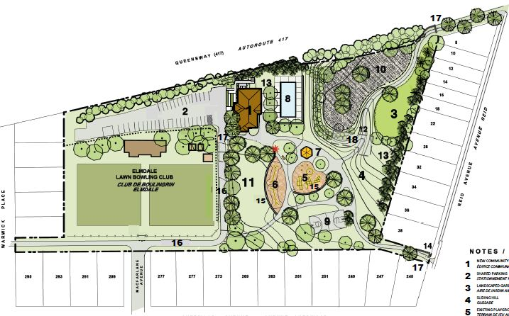
News: Reid Park
Field House Construction Delayed to Spring

Slide 10
News: Parkdale Beautification
$22,000 in “Section 37” funds from developments on Parkdale
Options: Benches, Welcome Signs, Flowers, Banners

Slide 11
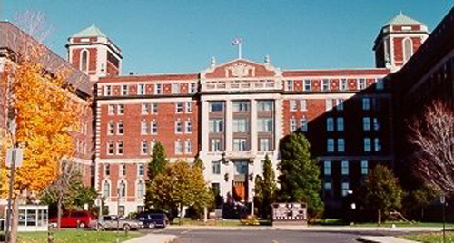
News: TOH Community Advisory Council
If you want an insight to what is happening at the Ottawa Hospital, read the regular CAC report by our own Dr. Gisele Microys

Slide 12
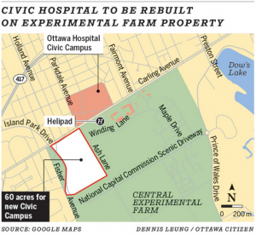
News: A New Civic Campus
Nov 3. Announcement by Feds, Ag Canada and NCC
Lease of 60 acres of the Experimental Farm to the Ottawa Hospital to build a new Civic

Slide 13
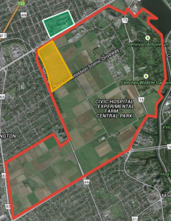

Slide 14
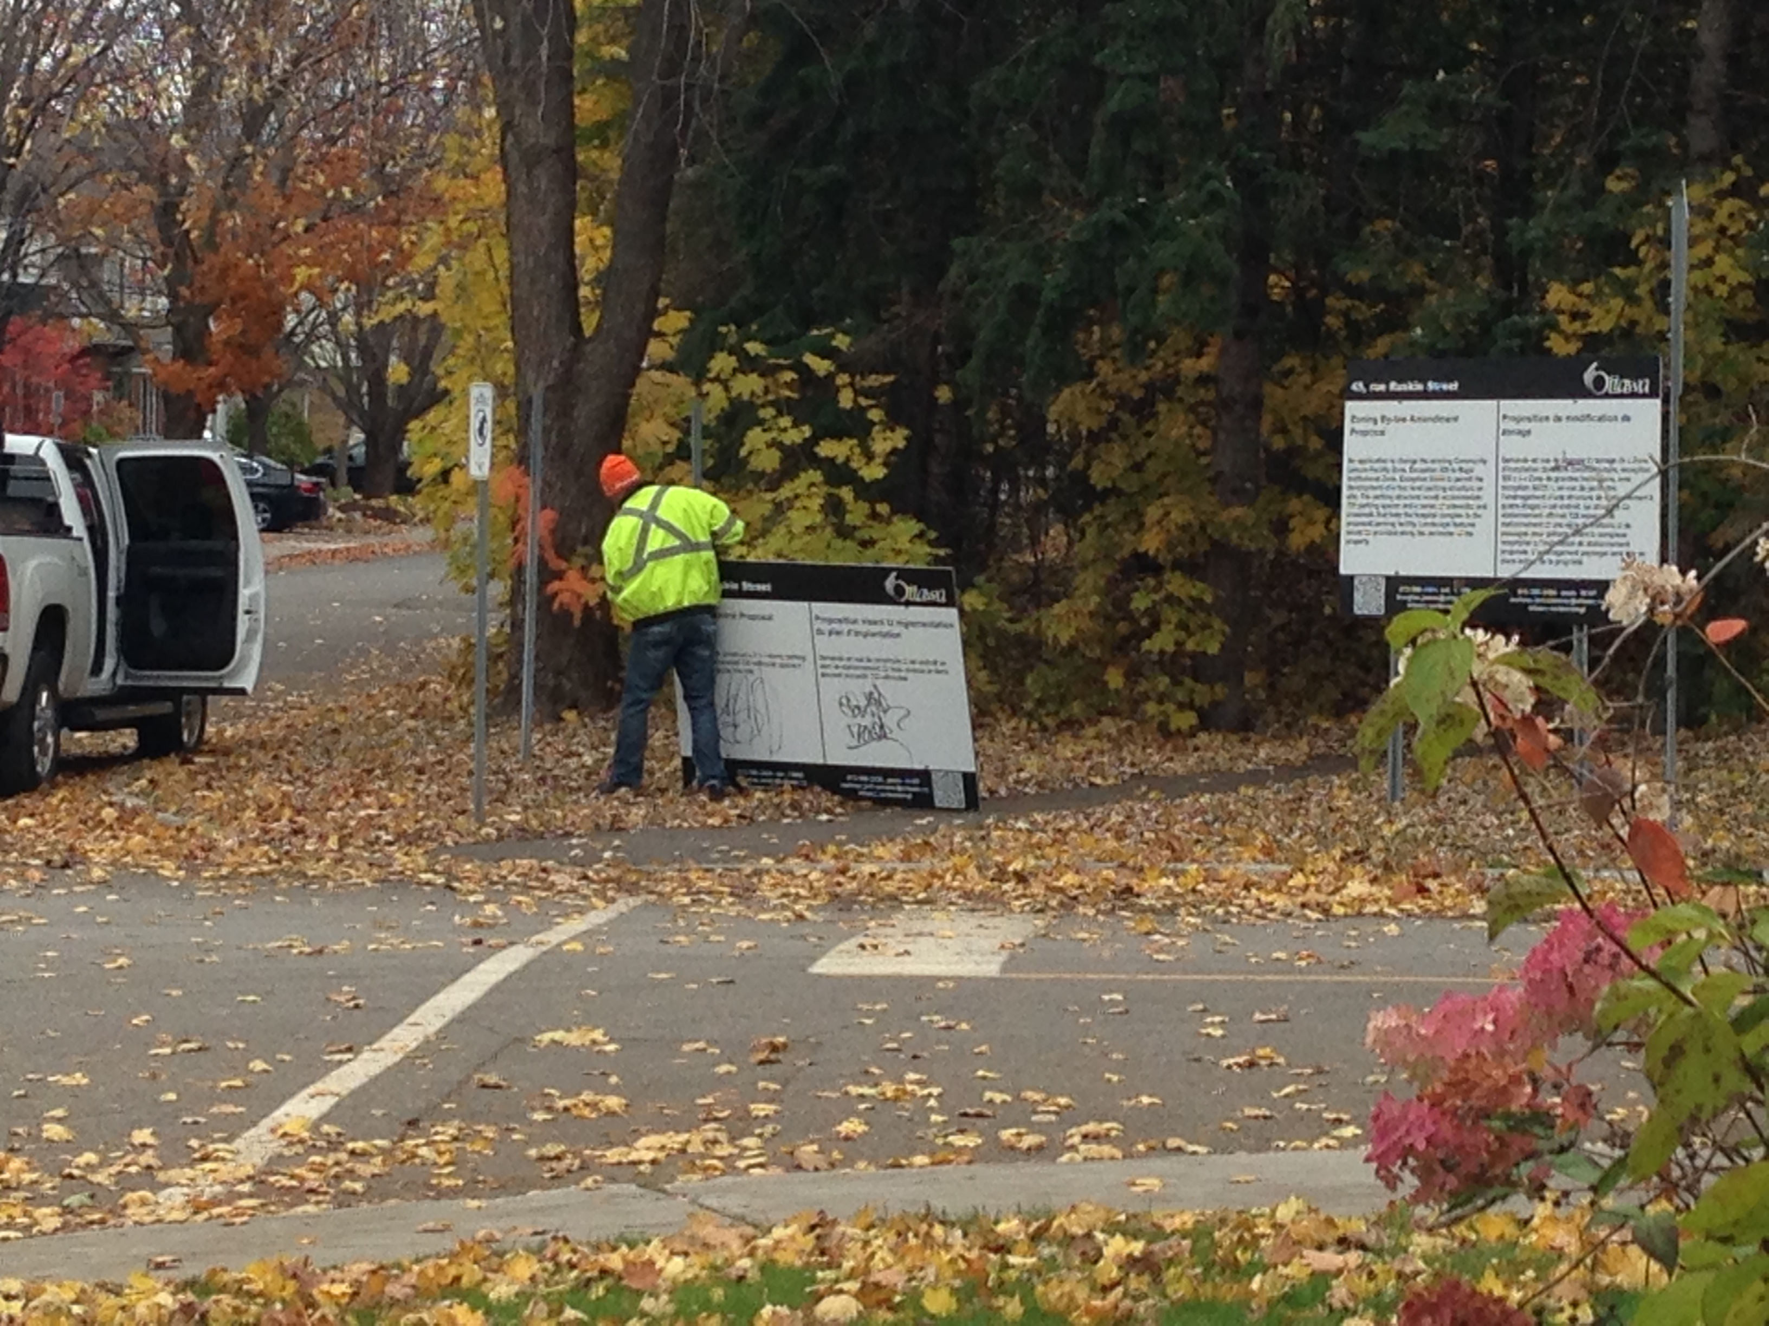
News: Hospital Parking
On Hold since February.
November announcement.
Ruskin Garage application will not proceed.
  Expanding on campus parking
  Sept. 1, moved hundreds of staff offsite and out of P1, making space available to patients and visitors
  Focus is on the HI expansion and their 2020 Master Plan

Slide 15
2014-2015 CHNA Executive Committee Election
Roles and Nominees (*returning)
  President – Karen Wright *
  Vice President – Peter Eady*
  Treasurer – Julie Westall*
  Development – Kathy Kennedy*
  Safety – Shane Quinn*
  Traffic - Luanne Calcutt
  Communications - Alyson Queen
  Secretary – Katherine Steinhoff
  NEW Role: Fundraising and Membership – Shelley Mullins

Slide 16
Constitution and Traffic –Peter Eady

Slide 17
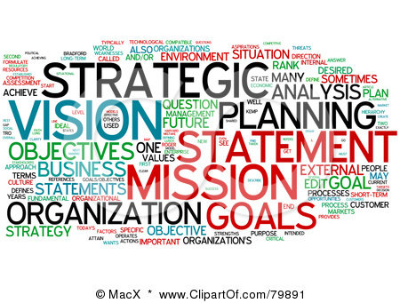
Planning – Kathy Kennedy

Slide 18
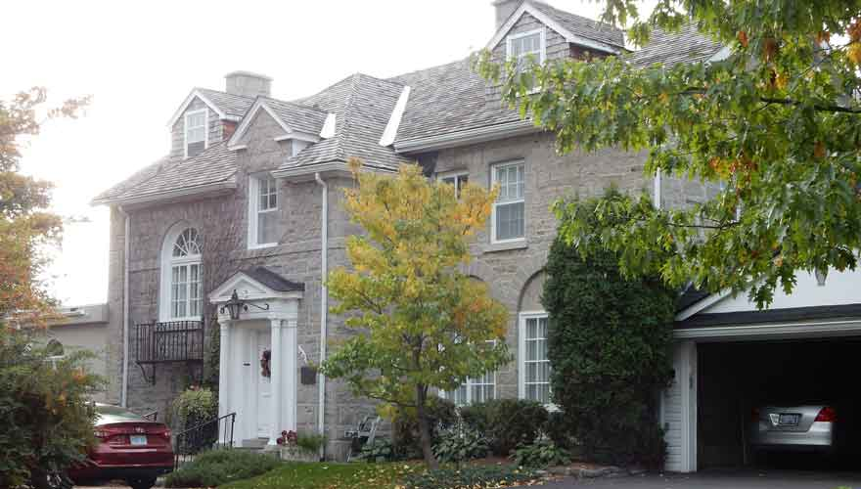
Planning (con’t) – Kathy Kennedy

Slide 19
Motions - George Laing
Motion 1: That the CHNA resolves that municipal campaign financing by corporations and unions must be prohibited. -NOT Approved
Alternate wording proposed: That the CHNA resolves that municipal campaign financing shall be by individual citizens only; corporations and unions must be excluded. - Approved.

Slide 20
Motions - George Laing
Motion 2: That the CHNA resolves that members of the City Planning Committee and City Council must recuse themselves from votes and discussions on any agenda items where they have a conflict of interest, and that a conflict of interest includes accepting campaign donations from individuals or businesses associated with those items. - Tabled

Slide 21
2013/2014 Treasurer Report – Julie Westall
$1163.94 - Revenues (membership, donations, cash sponsorships)
$3998.60 - Expenses (events, Church rentals, membership dues, webhosting, Ruskin lot, signage etc.)
$4188 - Balance carry-forward*
  Some of the balance may be used towards purchasing equipment for the new Reid Park Fieldhouse and running additional events.

Slide 22
Safety – Shane Quinn

Slide 23
2014-2015 CHNA Executive Committee Election – ALL Elected by Acclamation
Roles and Nominees (*returning)
  President – Karen Wright *
  Vice President – Peter Eady*
  Treasurer – Julie Westall*
  Development – Kathy Kennedy*
  Safety – Shane Quinn*
  Traffic - Luanne Calcutt
  Communications - Alyson Queen
  Secretary – Katherine Steinhoff
  NEW Role: Fundraising and Membership – Shelley Mullins

Slide 24
Guest Speaker – Councillor Elect Jeff Leiper

Slide 25
Open Discussion and Feedback

