Slide 1
Civic Hospital Neighbourhood Association
Spring Information Meeting
June 8, 2022
www.chnaottawa.ca

Slide 2
CHNA Agenda
Review of Agenda and General Remarks: Karen Wright, President
Environment: Carol Clemenhagen
New Civic: Peter Eady , VP and Luanne Calcutt
Transportation –Sherwood/Kenilworth: Luanne Calcutt
History and Heritage: Matt Lemay
Planning and Development Toolkit: Linda Niksic
1081 Carling: Luanne Calcutt
Home Security and Fraud Prevention: Shane Quinn
Board Positions: Karen Wright
Kitchissippi Ward Update/Q&A : Councillor Jeff Leiper
Adjournment

Slide 3
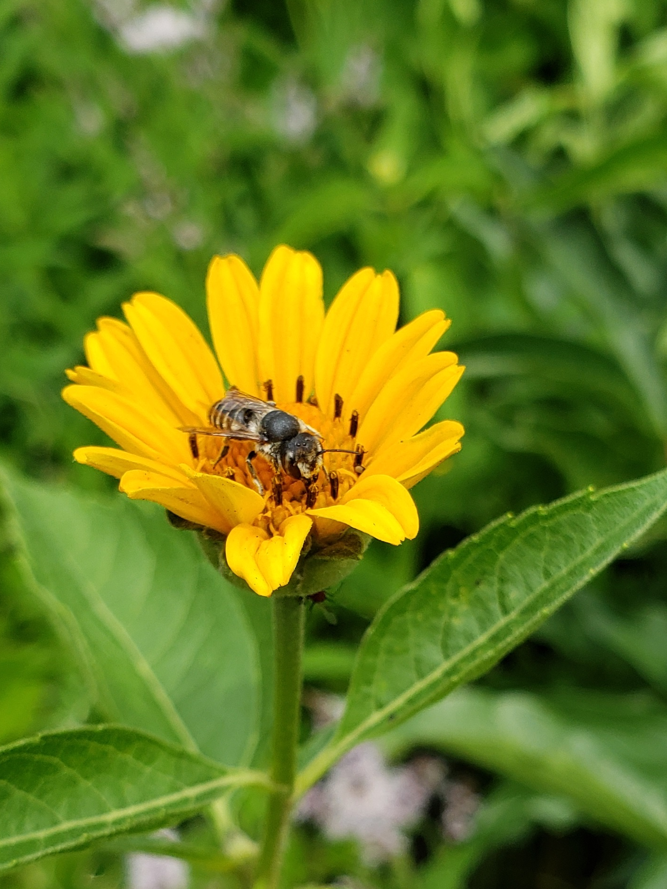
Environment – Carol Clemenhagen
Native Plant Garden – June 26.
Spongy Moth Burlap Initiative
Neighbourhood Tree Walk – Sept 17

Slide 4
Community Advisory Council Peter Eady & Luanne Calcutt

Slide 5
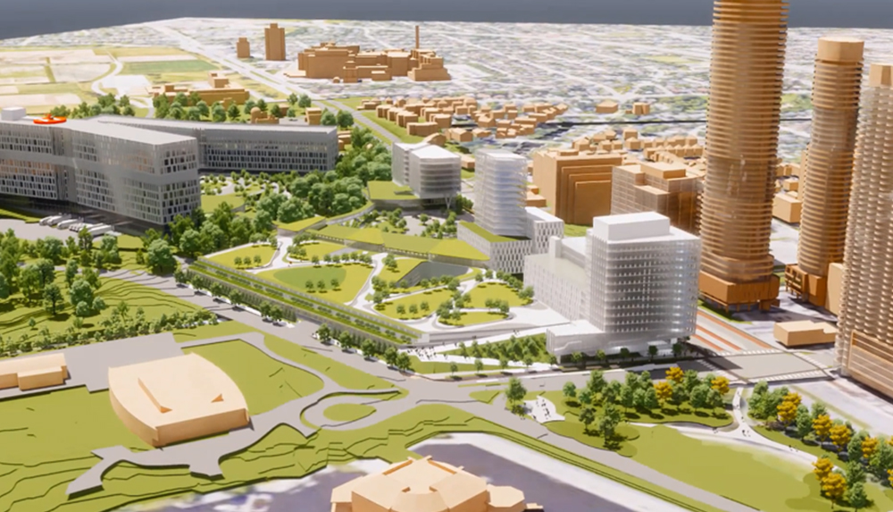
Community Advisory Council Transportation Subcommittee
Neighbourhood Traffic Management Study
Off Site Parking Strategy
Transportation Demand Management Program
Transportation Monitoring Strategy

Slide 6
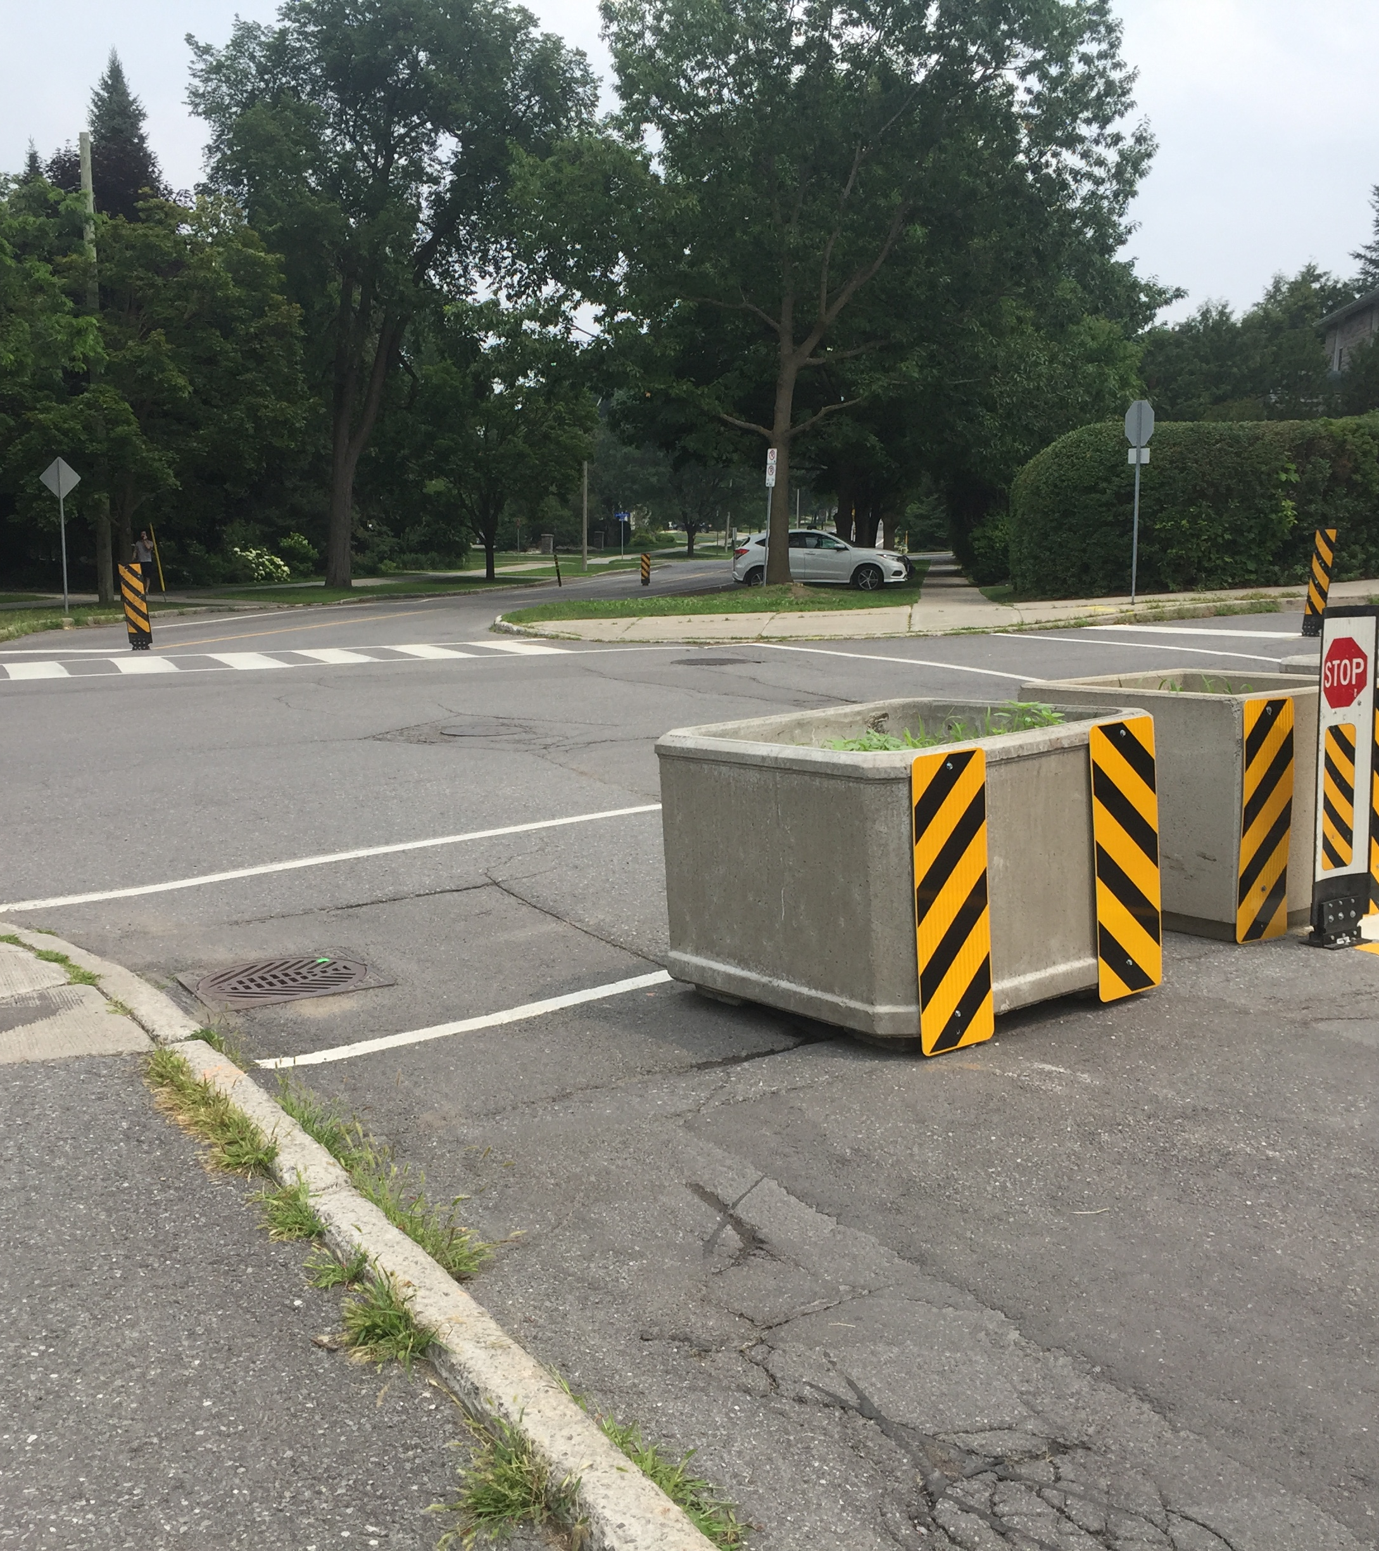
Sherwood and Kenilworth Update Luanne Calcutt

Slide 7
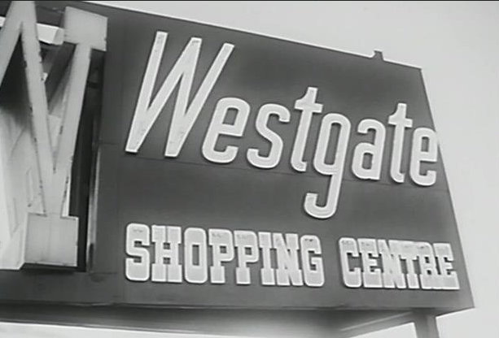
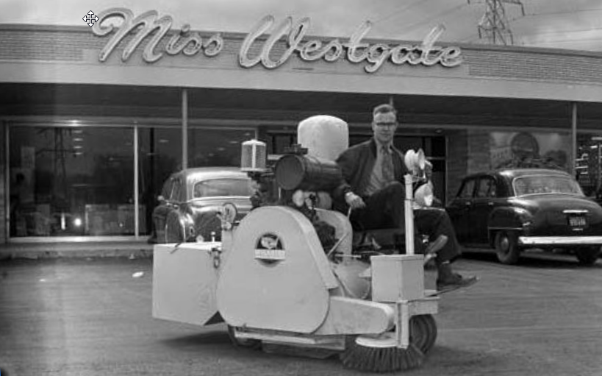
Neighbourood History and Heritage Night - Matt Lemay
Is there any interest for an in-person history evening of history this fall?

Slide 8
2022 CHNA Planning and Development Tool Kit Linda Niksic
DRAFT – WORK IN PROGRESS
1. CHNA Planning and Development Committee’s Guiding Principles
2. Examples of Proposed Developments and work to apply Guiding Principles
3. City of Ottawa New Official Plan
4. City of Ottawa Zoning By-law Review
5. Intensification Plans

Slide 9
Community Design Plans
City of Ottawa Planning and Development Slide Presentations
Interesting Planning and Development Measures
Key Links to Resources
ANNEX A (Pages 13-16):
Near Future and Ongoing Focus: Three Developments Impacting Our Community, including chart overview of CHNA ACTIONS
ANNEX B (Page 17-18):
Impact of Surrounding Developments on Preston Street and Carling Avenue

Slide 11
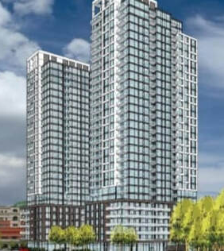
1081 Carling Ave Luanne Calcutt

Slide 12
Home Security and Fraud Prevention -Shane Quinn
Social Media
Alerts
Website
Mandate
Crime Prevention Resources
Incident reporting

Slide 13
Board Positions Karen Wright

Slide 14
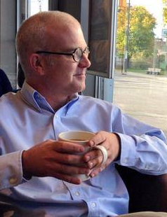
Kitchissippi Update Councillor Jeff Leiper

Slide 15
ADJOURNMENT

