Slide 1
Civic Hospital Neighbourhood Association
Annual General Meeting
Nov. 10, 2021
www.chnaottawa.ca

Slide 2
CHNA Agenda
Review of Agenda and General Remarks: Karen Wright, President
Ottawa Centre Update/Q&A: MP Yasir Naqvi
Election Time- CHNA Board: Peter Eady , VP
History and Heritage: Matt Lemay
Membership Matters: Susan Chell
Home Security and Fraud Prevention: Karen Wright
Finance Snapshot: Julie Westall
Ottawa Centre Update/Q&A : MPP Joel Harden
Planning and Development Update: Karen Wright
1081 Carling Subcommittee: Luanne Calcutt & Tanis Halpape
Transportation Committee: Luanne Calcutt
Kitchissippi Ward Update/Q&A : Councillor Jeff Leiper
Adjournment

Slide 3
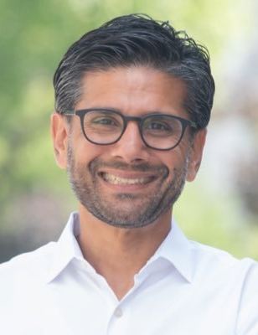
Ottawa Centre Update MP Yasir Naqvi

Slide 4
2022 CHNA Election -Peter Eady
Roles and Nominees (*returning)
Executive Board
President – Karen Wright *
Vice President – Peter Eady*
Treasurer – Julie Westall*
Secretary – OPEN
Security & Fraud – Shane Quinn*
Transportation - Luanne Calcutt*
Environment – Laurel McIvor*
Planning & Development –Linda Niksic*
Membership – Susan Chell*
Communications - Chris O’Gorman
Heritage and History –Matt Lemay*
Subcommittee Leads
1081 Carling – Tanis Halpipe (Luanne Calcutt board liaison)
Notes:
Andy stepping down as Co-Chair.

Slide 5
2022 CHNA Board Election
Additional Opportunities - OPEN
Exec Board Members At Large
Subcommittee Leads
Fundraising and Sponsorship
Special Events

Slide 6
History and Heritage’s Andy Billingsley -Matt Lemay

Slide 7
Membership – Susan Chell
Current membership
Percentage change in membership – significant increase in lifetime members
Initiatives to increase membership in the upcoming year

Slide 8
Home Security and Fraud Prevention
Formerly know as Safety Committee
Focus on crime and fraud prevention
Community Police Officer (CPO) is our primary point of contact
Notes:
The focus of the Safety Committee is on crime and fraud prevention in the Civic Hospital neighborhood..
After consultation with our members, we updated the name to Home Security and Fraud Prevention to more precisely reflect its activities.
The Community Police Office is our primary point of contact though COVID has limited interaction for the time being.

Slide 9
Home Security and Fraud Prevention
Safeguard Your Home (SGYH) Program
CHNA Posts warnings of break-ins and Fraud on our Social Media channels
Rising car related crime
Always lock doors and remove all possessions
Report to OPS Reporting Centre
Notes:
Home Safety
The best way to prevent burglaries is to get a Home Security Inspection from our CPC.
CHNA posts warnings on our social media channels of break-ins and other suspicious activities.
This year has seen continued car break-ins and thefts across the City including the Civic neighborhood.
The easiest way to prevent car thefts is to always lock doors.
Fraud:
Fraudulent activity is frequent and on-going and numerous incidents are posted to our website.
Reporting to Police:
When a violation does occur, it is important to file a formal report to the OPS Reporting Centre.
Information on submitting these reports, online or by phone, can be found on our website

Slide 10
Finance – Julie Westall
Membership Revenue $4567.10
Donations $1000
Expenses $1504.28
Total Available $19,822.16

Slide 11
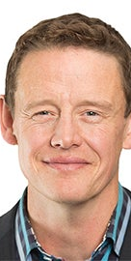
Ottawa Centre Update MPP Joel Harden

Slide 12
Planning and Development
Your Voice Matters
Share Your Views To Help Shape How Our Community Develops
Now and In The Future

Slide 13
P&D – 3 Key Areas of Focus
Provide analysis of benefits and work to mitigate concerns in Development Proposals/Plans/Reviews:
New Civic Hospital Master Site Plan
Supporting our Civic Hospital Relocation Committee
City of Ottawa New Official Plan
Zoning By-Law Review
Secondary Plans
Notes:
On Wednesday, October 26th City Council approved the New Official Plan. The policy will now go to the Ministry of Municipal Affairs and Housing for adoption and implementation. This is the first new official plan created since amalgamation and will iguide growth for the next 25 years. The CHNA worked with local community associations and groups reviewing and commenting on the many drafts of this important document. The document looks to balance the need to maintain our green canopy with the need to provide additional and affordable housing options for a growing city. The next 3 years will be spent working on the new zoning changes that will be needed to implement the plans and targets outlined in the New Official Plan

Slide 14
P&D – 3 Key Areas of Focus
2) Protect character of our mature neighbourhood
Support New October 2020 Bylaw that limits the building of front facing garages unless they are the dominant style
Attend Committee of Adjustment Minor Variances
Creating a Toolkit for future requests

Slide 15
P&D - 3 Key Areas of Focus
Working on creative ways to respond to speed and volume of development proposals shaping our neighbourhood
Working with community to establish new 1081 Carling Avenue Subcommittee
Work with other neighbourhood associations and community groups

Slide 16
P&D - 1081 Carling Subcommittee
Opportunity to use as ‘case study’ for other potential developments in CHN (e.g. Holland, Fairmont, Irving, Sherwood, Bayswater, Breezehill, Loretta, Champagne...)
Advisory body to make recommendations to CHNA Board
8 members including CHNA liaison; Chair, Tanis Halpape
Raise funds through donations to cover all costs associated with and to support work including payment for professional advice.
CHNA officially responded to proposal to develop two (28,22 storeys) towers; 53 residents also submitted and there is still time.

Slide 17
1081 Carling Subcommittee
Could set a precedent for height and density of future developments along Carling Ave.
Proposal is inconsistent with City’s policy of gradual height transition requiring a 45 degree transition in the scale of buildings located next to lower-density neighbourhoods. Proposal is for an abrupt change of a 72 degree angle.

Slide 18
Transportation Committee
Vincent Beswick-Escanlar
Christina Cameron
Tanis Halpape
Keith Hobbs
Anish Mehra
JoAnne Monty
Mark Scrivens
Wendy Jarath
Chair – Luanne Calcutt

Slide 19
New Civic Site Plan – CHNA Response
Submission met June 18 deadline for public comments
Participated in June 29 Public Information Session – strategic questions raised
Tremendous amount of work over summer by CHNA’s Transportation Committee
CHNA conditions for approval letter sent to City – Aug 25
Presentation of 8 conditions for approval - Oct 1st City Planning Committee meeting
Worked with J. Leiper to develop motion for funds to conduct a Neighbourhood Traffic Management Study
Final decision by City included special conditions

Slide 20
New Civic Site Plan – CHNA Conditions
Provision of funds for the study, consultation, and implementation of local traffic mitigation strategies
Conduct a neighbourhood traffic management study and implement strategies to mitigate infiltration of traffic.
Improve Auto-driver Share Analysis; future auto-driver share be accurately forecasted by means of a survey of commuting modes at existing Civic Campus.
4. Provide an LRT station connection via either a below ground connection to the existing station or a below ground connection to extended platforms under Carling Avenue to the south side of Carling Avenue.

Slide 21
New Civic Site Plan – CHNA Conditions
That the proposed above ground parking garage be further buried to align with the initial design.
6. That any non-urgent vehicular traffic be restricted from using Maple Drive to access the New Civic.
7. TOH submit to the Province, an application for a change in H-sign placement prior to occupancy and opening of the new hospital in 2028.
8. Transportation Monitoring Oversight Committee (TMOC) - including representation of local community associations.

Slide 22
New Civic Site Plan – A few CHNA ‘wins’
1,2 A Neighborhood Traffic Calming Study is required…. including the expected traffic patterns and impacts to volume, speed and parking within 1500 metres of the Hospital site and mitigation options.
7 TOH must make an application to the Ministry of Transportation for the relocation of the Highway 417 hospital marker sign from the eastbound Parkdale Avenue off-ramp
8 A Transportation Monitoring Program, including but not limited to, phasing plan(s) and reporting mechanisms, shall be prepared.

Slide 23
New Civic Site Plan – A few CHNA ‘wins’
A Transportation Demand Management strategy shall be developed including recommendations for modal shift listed in the application.
Off-Site Parking Strategy is required prior to registration of the Site Plan Agreement

Slide 24
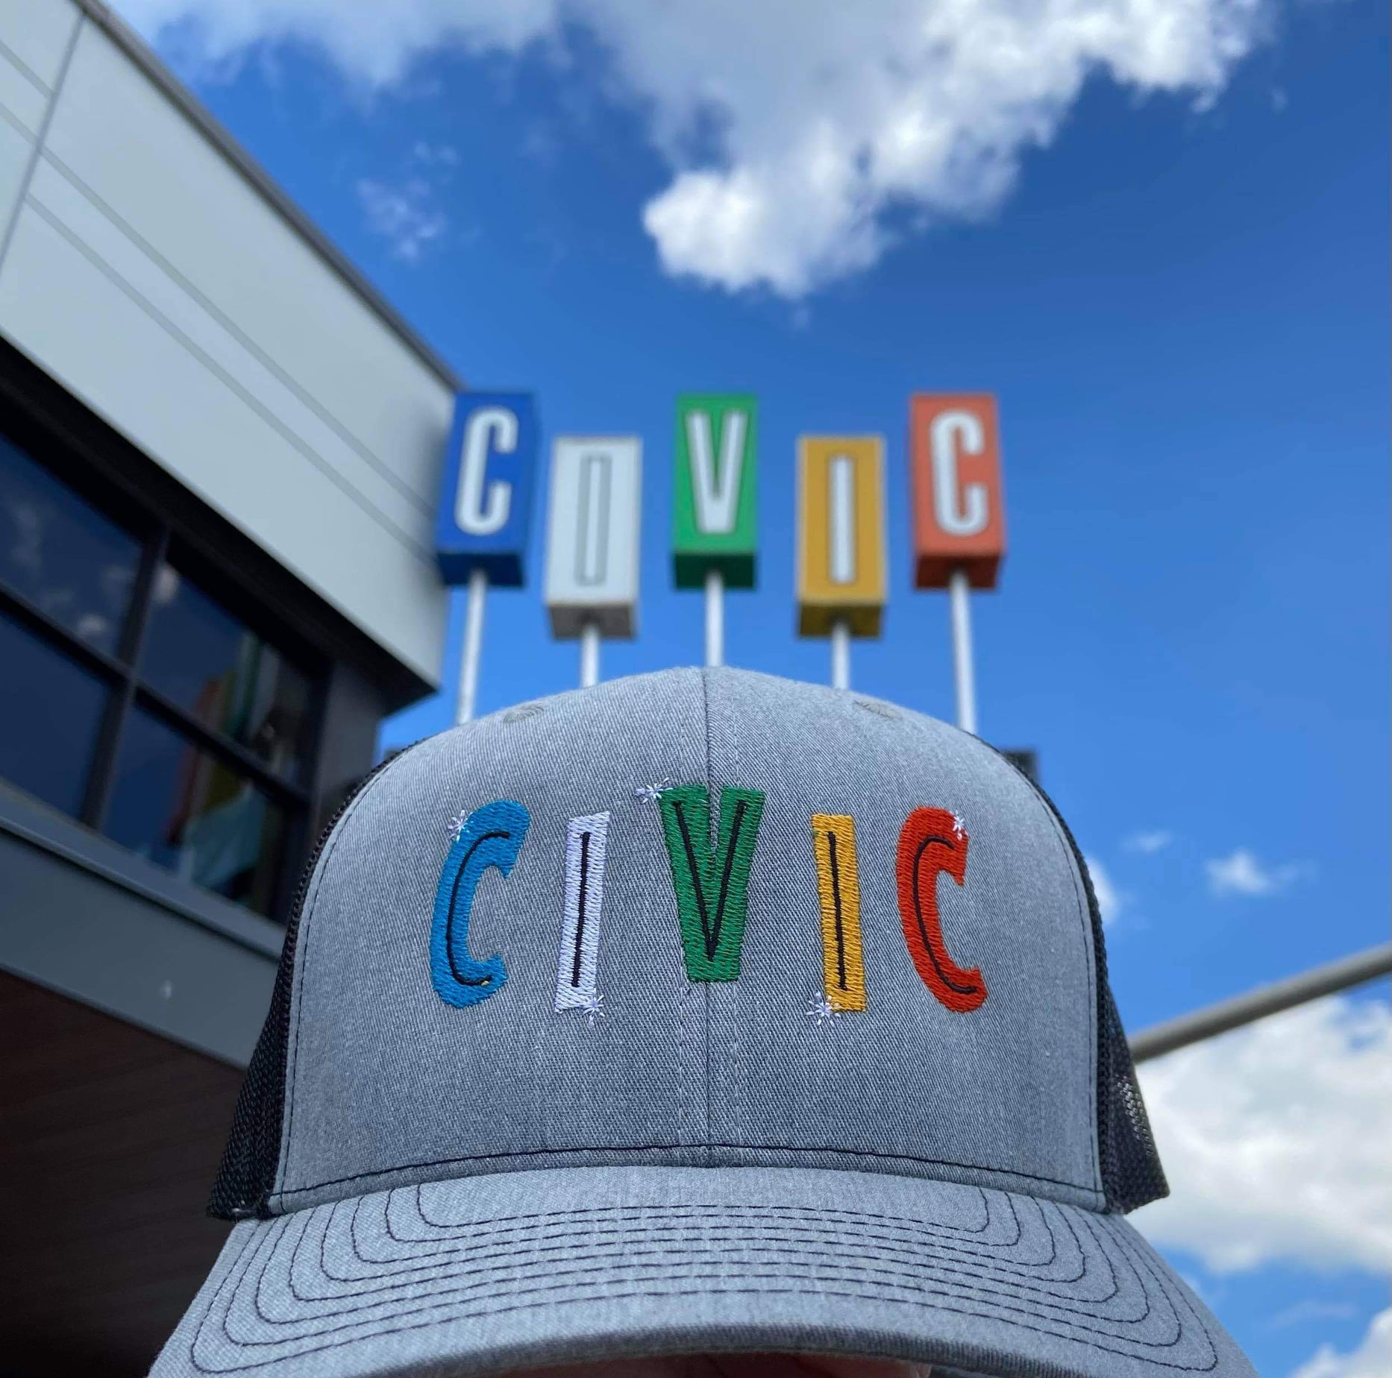
Fun Draw – Participate to Win!
Cap donated by local artisan Michael Moir
Cap donated by local artist Michael Moir
https://www.etsy.com/ca/shop/DamnFinePrintsCanada

Slide 25
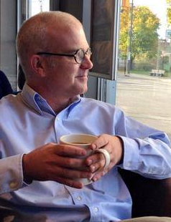
Kitchissippi Update Councillor Jeff Leiper

Slide 26
ADJOURNMENT

