Slide 1
Civic Hospital Neighbourhood Association Spring Information Meeting
May 25, 2016
www.chnaottawa.ca

Slide 2
CHNA Agenda
7:00 pm Review of Agenda and General Remarks: Karen Wright, President CHNA
7:05 pm Guest Speaker: Marion Fraser CFO, VP Finance and Admin- Heart Institute
UOHI Expansion Update
7:20 pm Spring Report: Karen Wright
7:45 pm Kitchissippi Update : Councillor Leiper
8:00 pm Light Refreshments and Networking
9:00 pm Adjournment

Slide 3
Heart Institute Update – Marion Fraser CFO, VP Finance and Admin

Slide 4
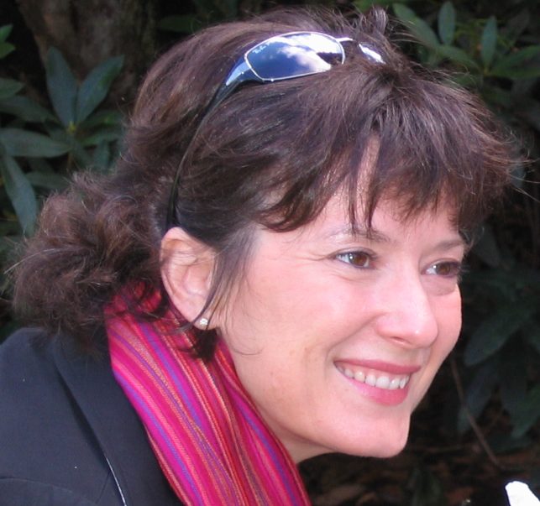
Spring Report – Karen Wright, President, CHNA

Slide 5
Kitchissippi Update – Councillor Jeff Leiper

Slide 6
Refreshments and Networking

