Slide 1

Civic Hospital Neighbourhood Association Spring General Meeting - May 27, 2015
www.chnaottawa.ca
@CHNAottawa
www.facebook.com/chnaottawa

Slide 2
CHNA
Agenda
7:00 pm Introduction - Karen Wright, President CHNA
7:10 pm Special Guest – Karen Secord, Coordinator, Parkdale Food Centre
7:25 pm Key Reports:
  Planning and Development – Kathy Kennedy
  History and Heritage – Andy Billingsley
  Traffic – Luanne Calcutt
  Safety - Shane Quinn, Safety Chair
  Membership - Shelley Mullins
  Communications - Alyson Queen
  Constitution – Peter Eady
  Treasury– Julie Westall
8:40 pm Councillor Chat/Q&A - Jeff Leiper
9:00 pm Adjournment

Slide 3
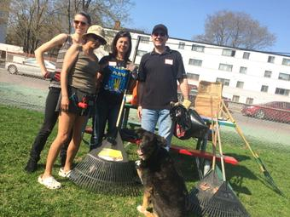

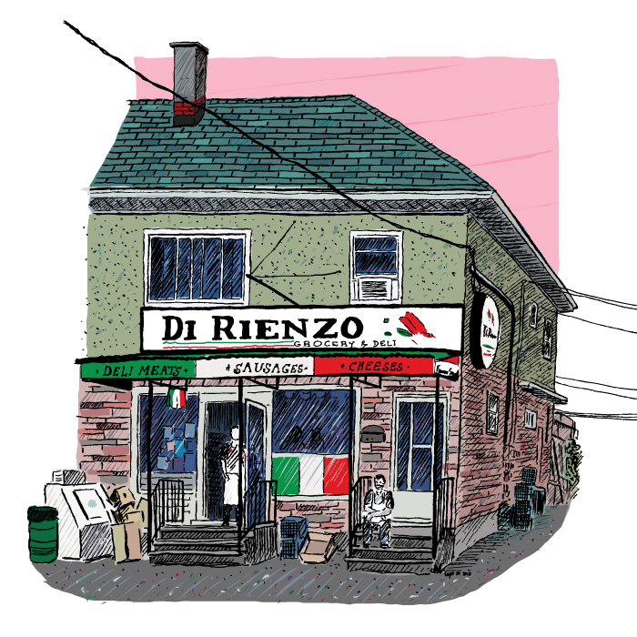

Thank you!

Slide 4

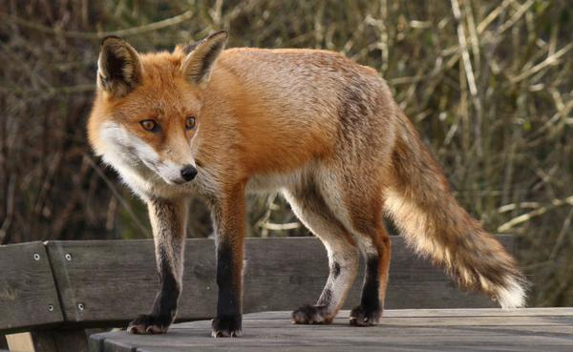
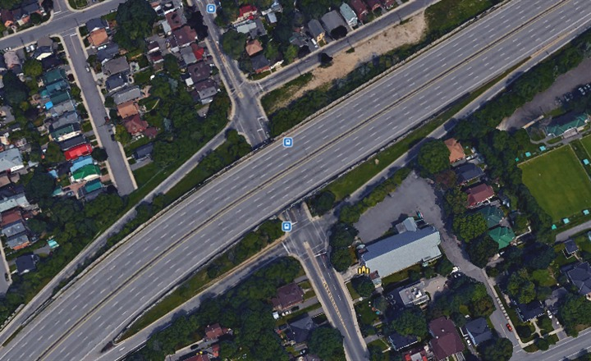




Keeping you Informed

Slide 5
CHNA
Agenda
7:00 pm Introduction - Karen Wright, President CHNA
7:10 pm Special Guest – Karen Secord, Coordinator, Parkdale Food Centre
7:25 pm Key Reports:
  Planning and Development – Kathy Kennedy
  History and Heritage – Andy Billingsley
  Traffic – Luanne Calcutt
  Safety - Shane Quinn, Safety Chair
  Membership- Shelley Mullins
  Communications- Alyson Queen
  Constitution – Peter Eady
  Treasury– Julie Westall
8:40 pm Councillor Chat/Q&A - Jeff Leiper
9:00 pm Adjournment

Slide 6
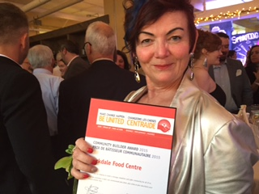
Parkdale Food Centre – Karen Secord
2015 United Way Community Builder Award

Slide 7
CHNA
Agenda
7:00 pm Introduction - Karen Wright, President CHNA
7:10 pm Special Guest – Karen Secord, Coordinator, Parkdale Food Centre
7:25 pm Key Reports:
  Planning and Development – Kathy Kennedy
  History and Heritage – Andy Billingsley
  Traffic – Luanne Calcutt
  Safety - Shane Quinn, Safety Chair
  Membership- Shelley Mullins
  Communications- Alyson Queen
  Constitution – Peter Eady
  Treasury– Julie Westall
8:40 pm Councillor Chat/Q&A - Jeff Leiper
9:00 pm Adjournment

Slide 8

Planning & Development (P & D) – Kathy Kennedy

Slide 9
P & D (Responsibilities)
CHNA Constitution, tasks the Planning and Development Committee (P&D) with:
  liaising with city officials and developers on proposed developments of concern to CHNA (meetings);
  drafting comments on proposed developments of concern to CHNA during the consultation phase of the City’s planning process (consultations and writing submissions); and
  working to influence the design of proposed developments to align them with the needs of the CH community (lobbying).

Slide 10
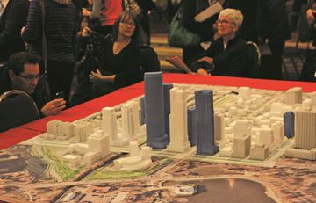
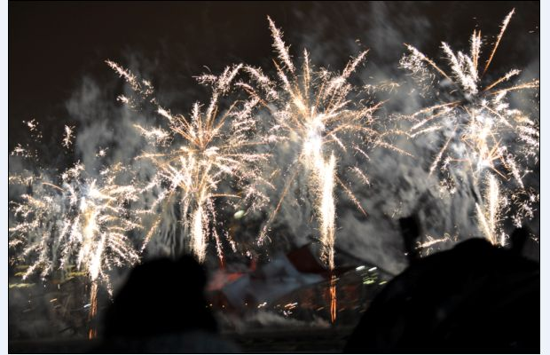
P & D (Liaison)
Queen Juliana Park: Cut-through road a dead-end!!!
Canada Day fireworks get go-ahead for Queen Juliana Park
NECO COCKBURN, THE OTTAWA CITIZEN 06.29.2012

Slide 11


P & D (Consultations & Submissions)
Draft CHNA Submission on the Rehabilitation of Ottawa Queensway Mid-Town Bridges - March 2015 (If you have any comments or input which you would like to see incorporated into this submission, please send them to kathyltk [at] gmail.com by end of day, Wednesday, March 11, 2015.) [Sent to Ministry of Transportation March 13]

Slide 12
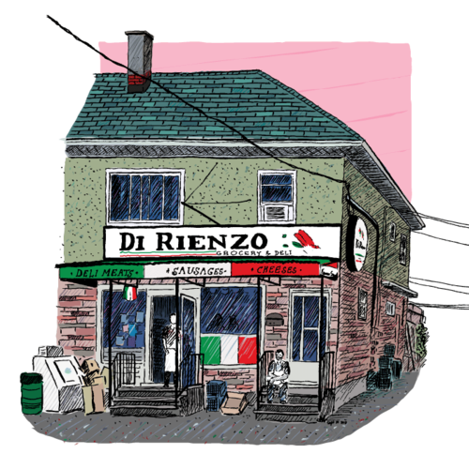
P & D (Consultations & Submissions)
Are there too few, too many or just the right number of local shops and services in our neighbourhood? (The CHNA Planning and Development Committee is looking for input from residents until January 27, 2014, so it can submit a CHNA-focused response.)
[Second submission sent to City of Ottawa Feb 6, 2015]

Slide 13
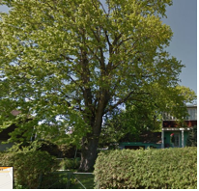

P & D (Submissions)
Committee of Adjustment Notice of Public Hearing
40 Young Street (2A to 2D) Railway Street CHNA Response submitted Nov 3, 2014
Urban Tree Conservation By-Law

Slide 14
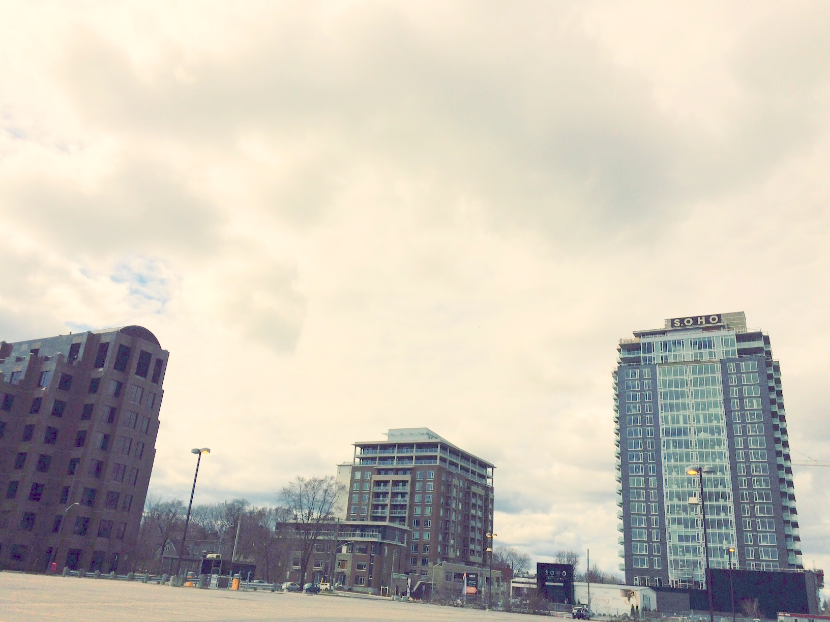
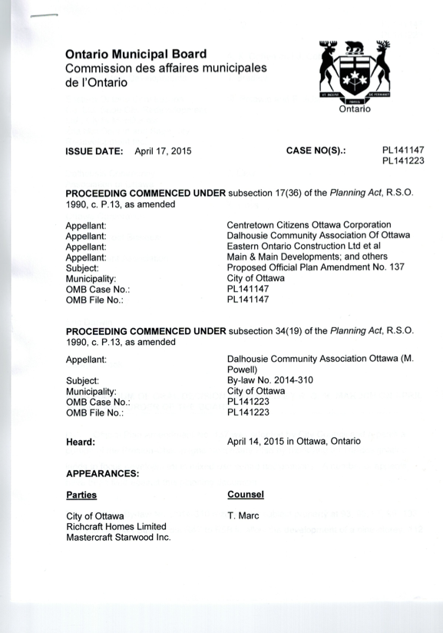
P & D (Ontario Municipal Board hearing)
CDP- Loretta/Hickory
OP – Ruskin

Slide 15
P & D (Vision for our Community)
  CHNA Planning & Development Committee Draft Strategic Plan (Contact plandev@chnaottawa.ca if you are interested in helping CHNA develop this vision.)
  [Open for input]
“…protecting and enhancing the liveability, sustainability, integrity and heritage of the CH community.”

Slide 16
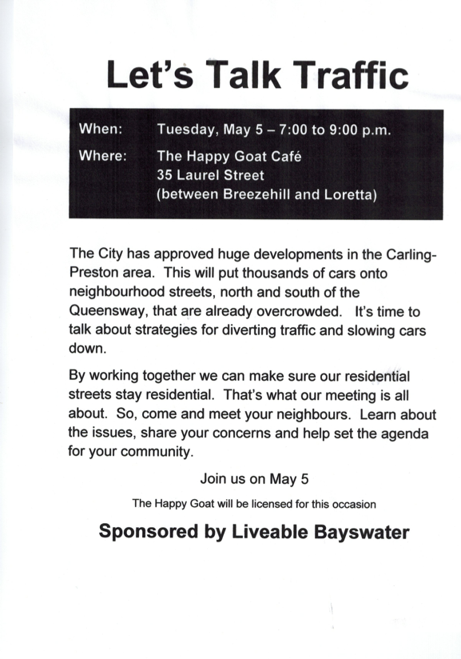
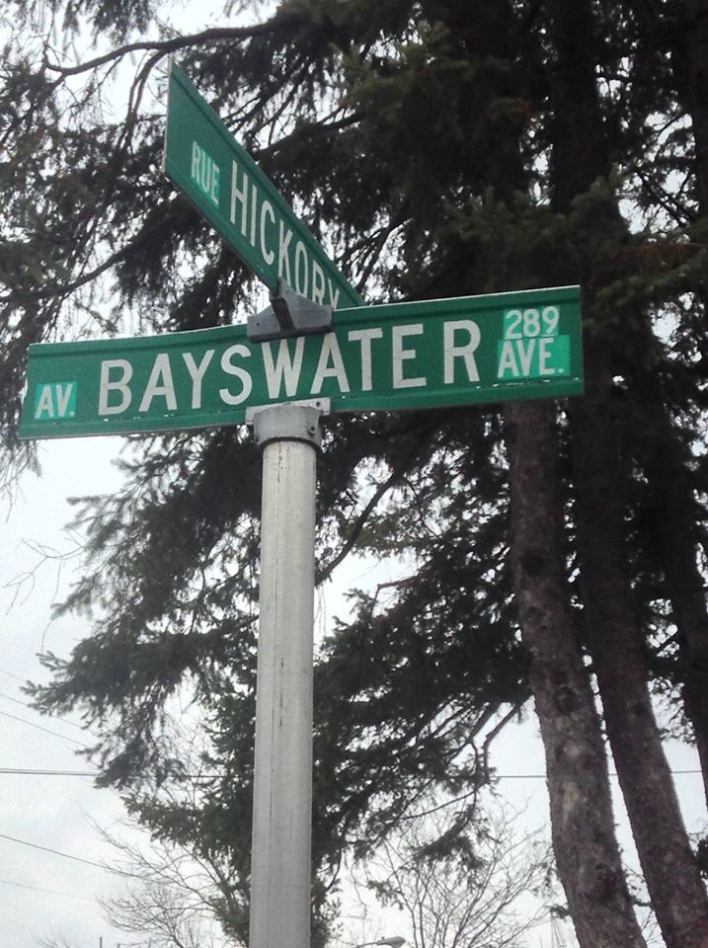
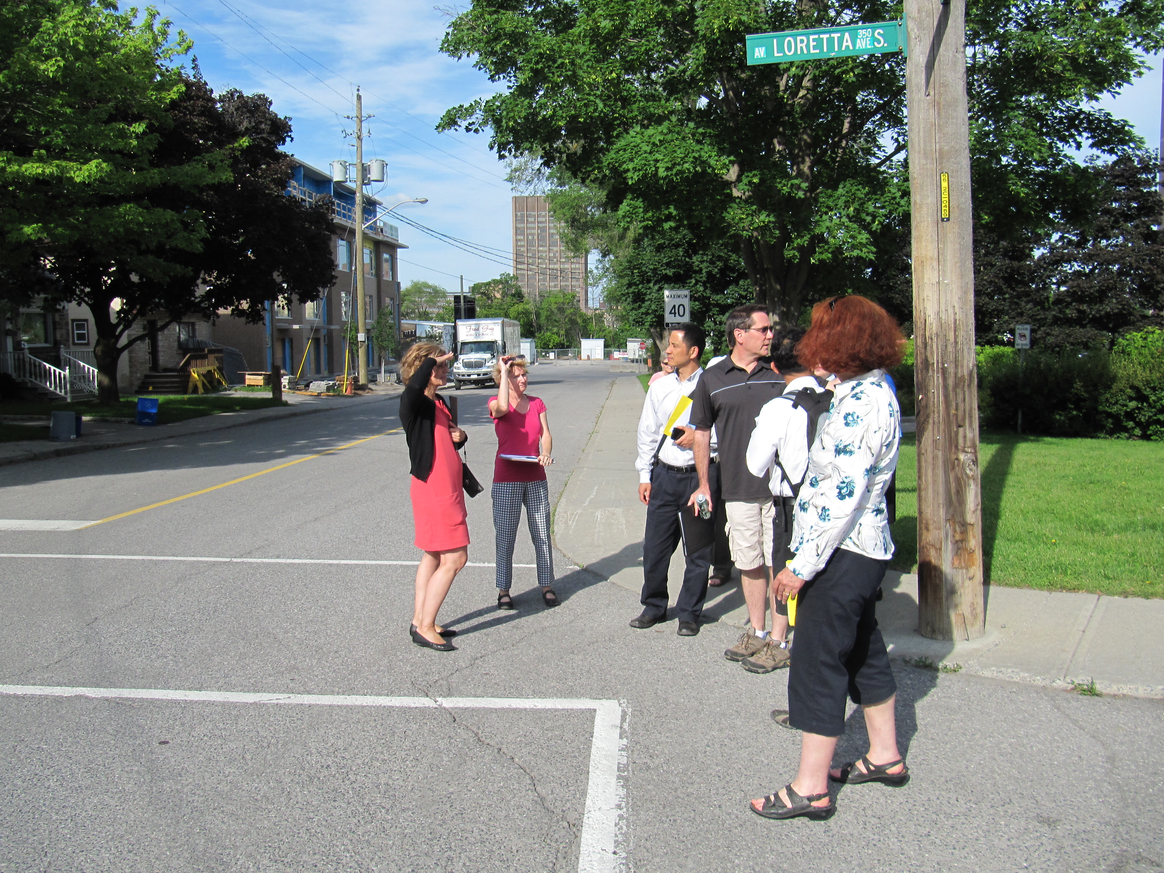
Liveable Bayswater Update

Slide 17
Planning & Development - Kathy Kennedy
Questions?

Slide 18
CHNA
Agenda
7:00 pm Introduction - Karen Wright, President CHNA
7:10 pm Special Guest – Karen Secord, Coordinator, Parkdale Food Centre
7:25 pm Key Reports:
  Planning and Development – Kathy Kennedy
  History and Heritage – Andy Billingsley
  Traffic – Luanne Calcutt
  Safety - Shane Quinn, Safety Chair
  Membership- Shelley Mullins
  Communications- Alyson Queen
  Constitution – Peter Eady
  Treasury– Julie Westall
8:40 pm Councillor Chat/Q&A - Jeff Leiper
9:00 pm Adjournment

Slide 19
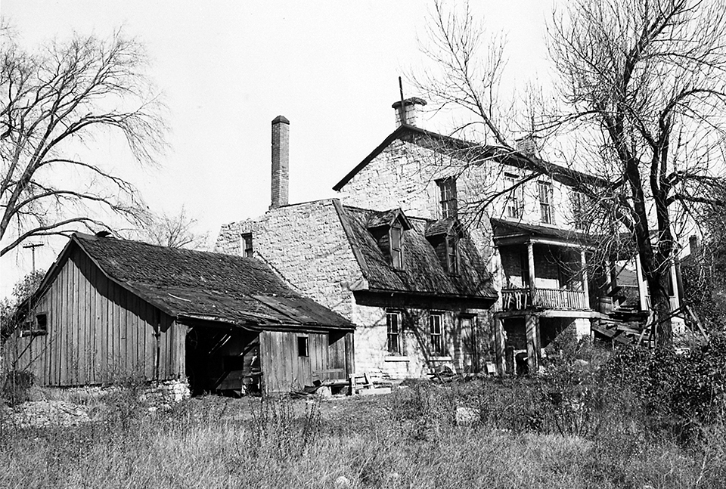
History & Heritage – Andy Billingsley
Reid house, 1941

Slide 20
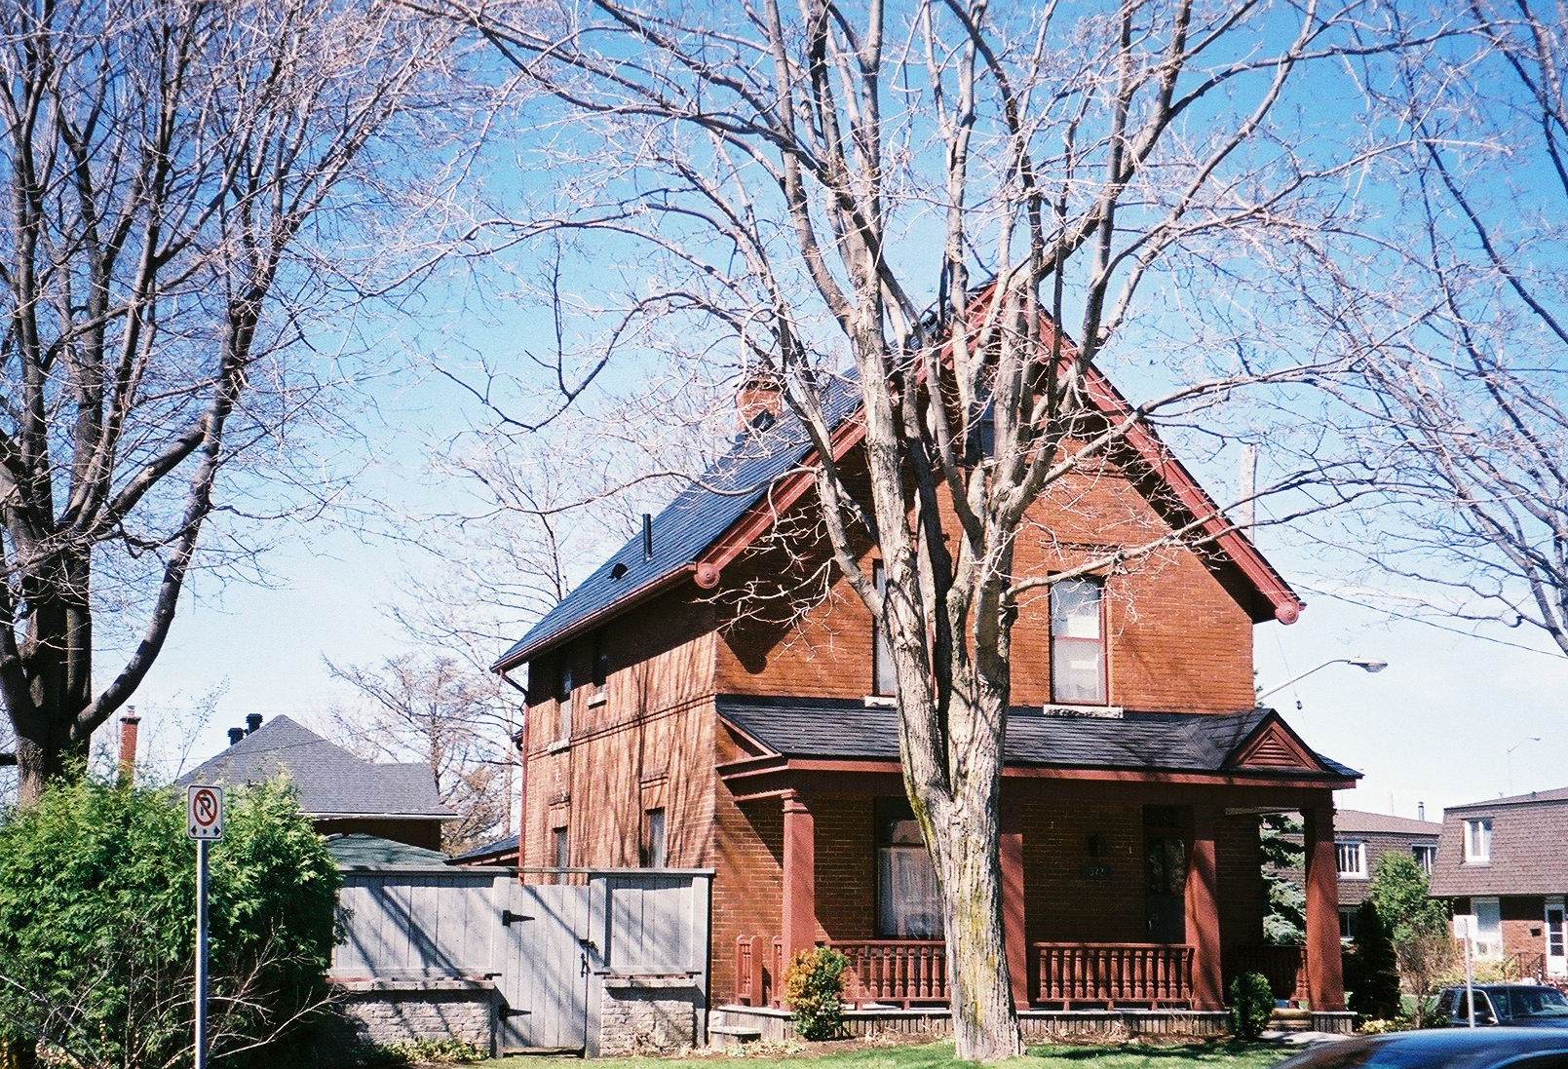
H & H (con’t) – Andy Billingsley
Truemner house, 2015

Slide 21
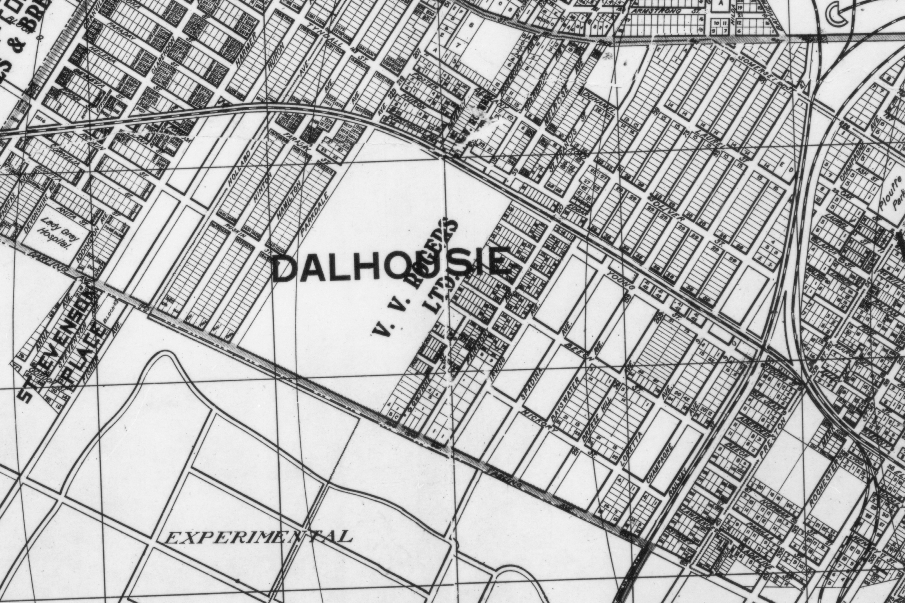
H & H (con’t) – Andy Billingsley
1915 neighbourhood map

Slide 22
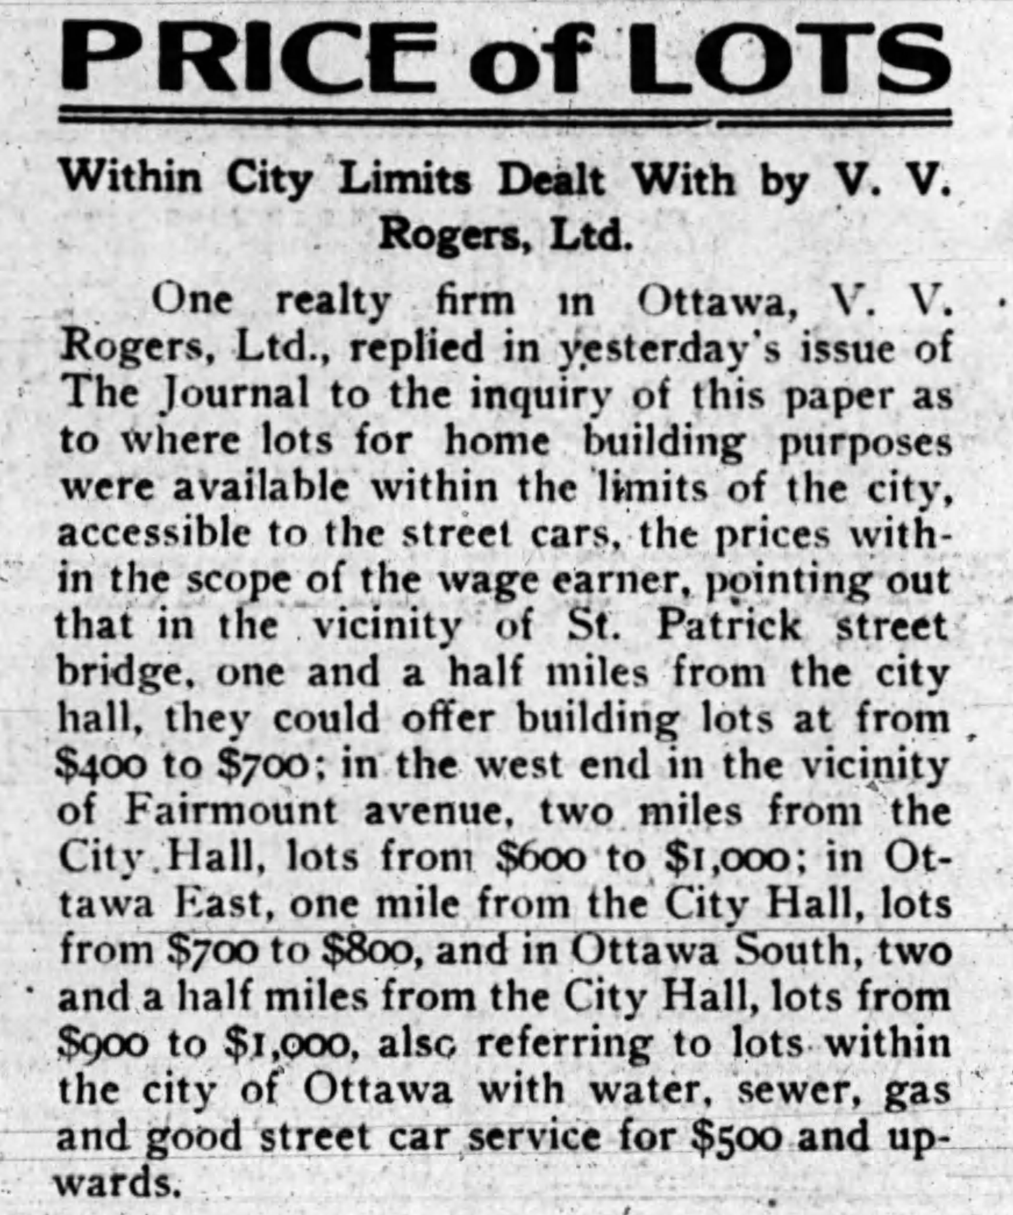
H & H (con’t) – Andy Billingsley
Fairmont property ad, 1913

Slide 23
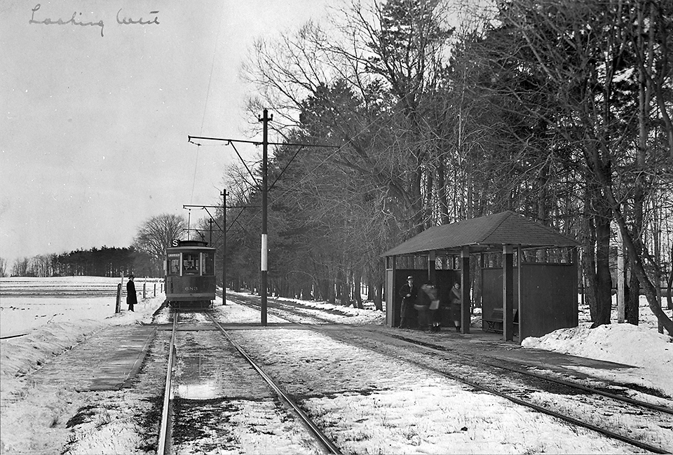
H & H (con’t) – Andy Billingsley
Streetcar stop for Civic, 1924

Slide 24
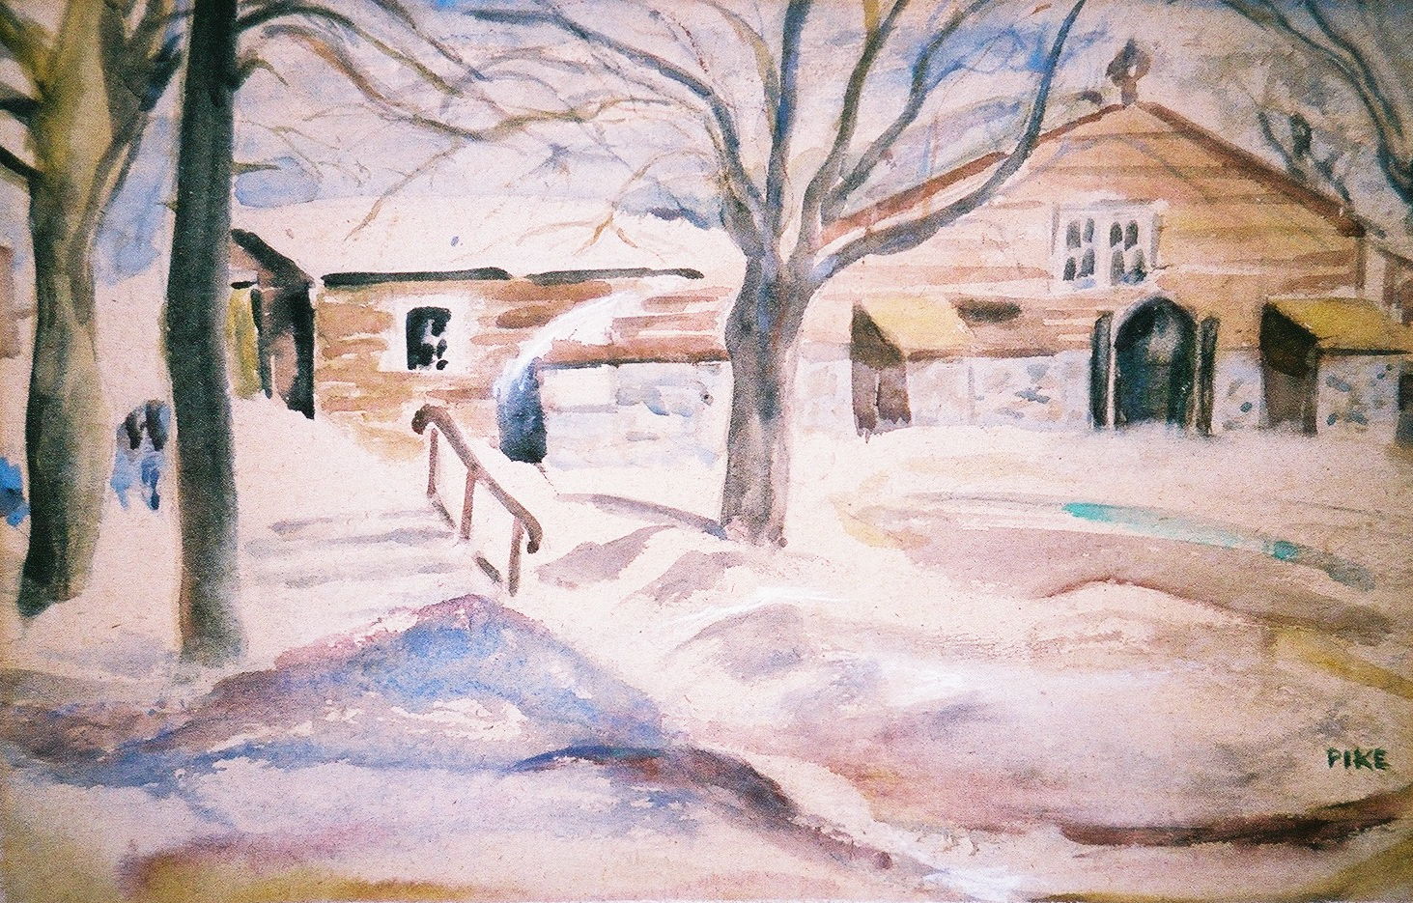
H & H (con’t) – Andy Billingsley
St. Matthias basement church, 1948

Slide 25
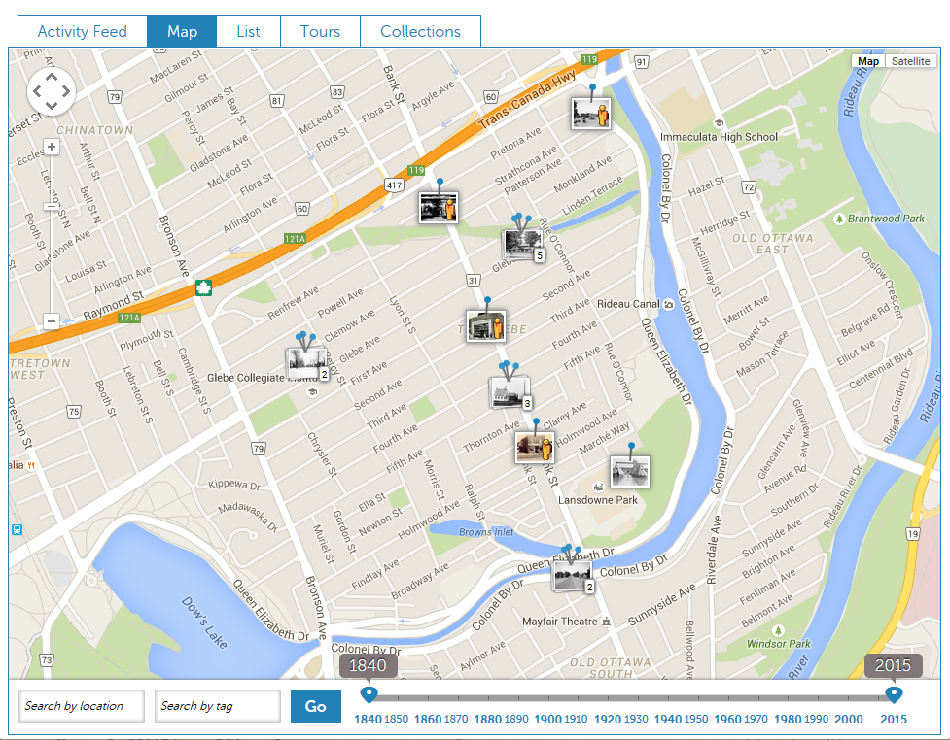

H & H (con’t) – Andy Billingsley
Historypin example - Glebe

Slide 26
CHNA
Agenda
7:00 pm Introduction - Karen Wright, President CHNA
7:10 pm Special Guest – Karen Secord, Coordinator, Parkdale Food Centre
7:25 pm Key Reports:
  Planning and Development – Kathy Kennedy
  History and Heritage – Andy Billingsley
  Traffic – Luanne Calcutt
  Safety - Shane Quinn, Safety Chair
  Membership- Shelley Mullins
  Communications- Alyson Queen
  Constitution – Peter Eady
  Treasury– Julie Westall
8:40 pm Councillor Chat/Q&A - Jeff Leiper
9:00 pm Adjournment

Slide 27
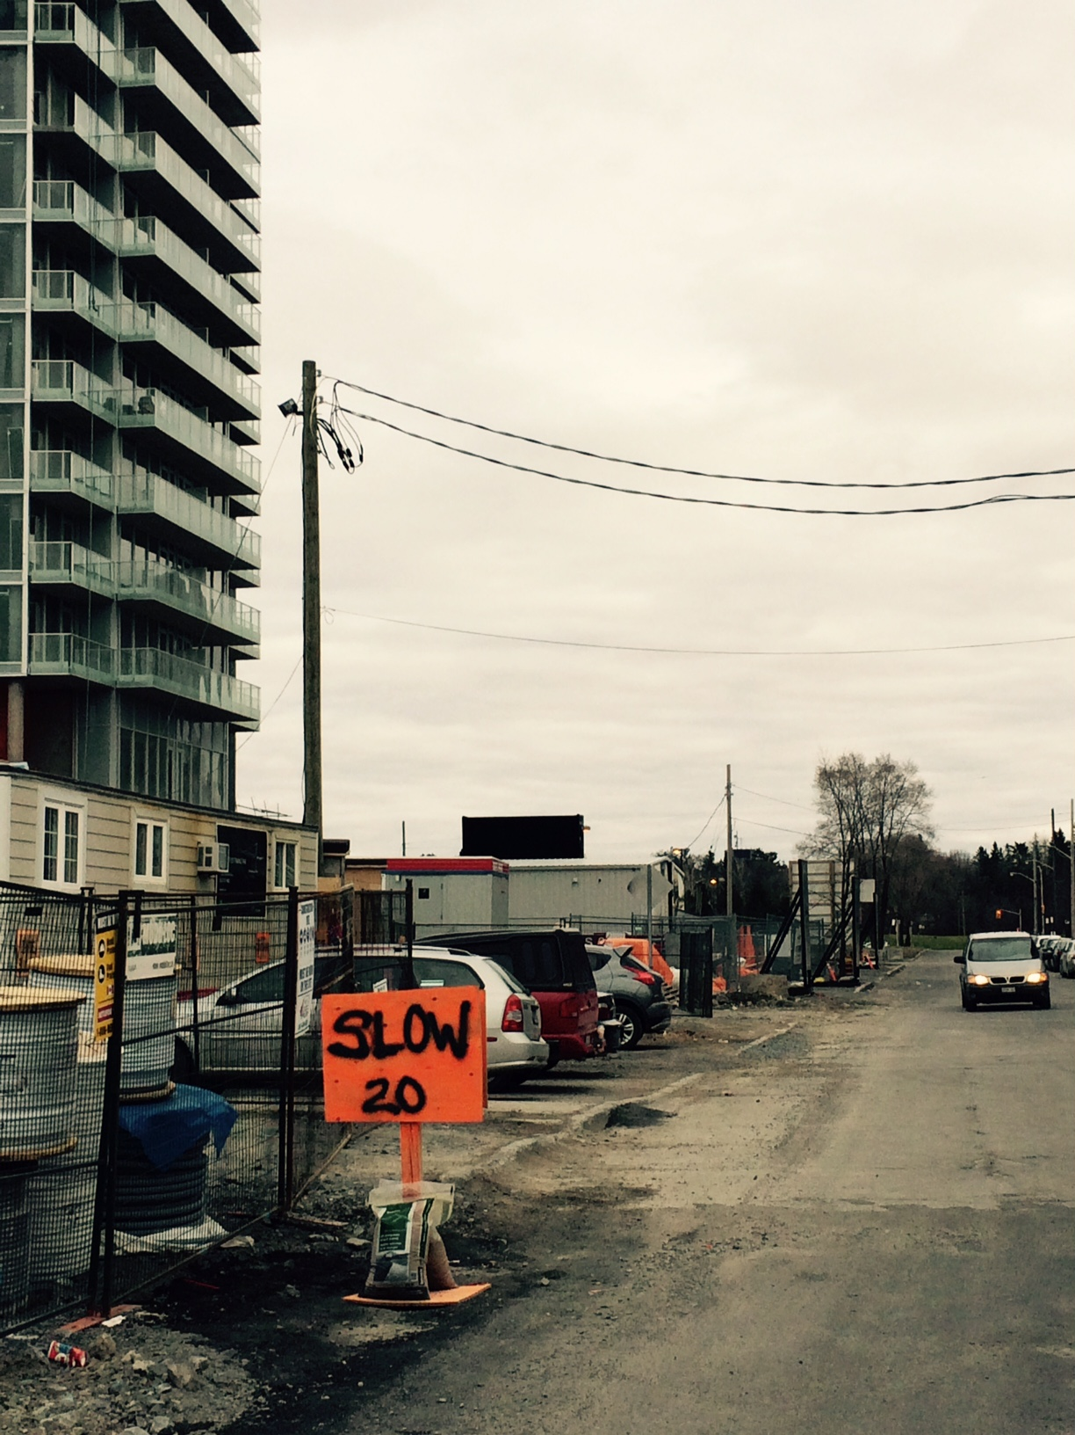
Traffic Committee – Luanne Calcutt
We fully support the ‘new’ speed limit on Champagne. How about lower speed limits on other streets too?

Slide 28
Civic Hospital Neighbourhood – Safer Streets
Seven areas of concern were prioritized by the Traffic Committee with multiple micro or local issues associated with each (an evergreen inventory);
The concept of neighbourhood ‘sectors’ naturally evolved that broadly align with these priority issues;
Implementation of micro-local ‘quick wins’ will be aligned with a campaign to increase CHNA membership lending credibility to neighbourhood concerns.

Slide 29
Residential Speed Limit – Safer Streets
Residents can petition City to reduce speed limit from 50 to 40 km/h (66 + 1%) on eligible roads;
CHNA ‘40 km/h Campaign’ has been effective :
- 22/41 street petitions have been launched;
- 12 streets now have reduced speed signs installed;
One step toward having safer streets is to obtain support for changing the speed limit to 40 km/h on all streets and to pursue this objective with street representatives.

Slide 30
Residential Speed Limit – Safer Streets
It is anticipated that this ‘quick win’ will be reached in the coming months;
Street representatives will fan out to meet neighbours and request support through a 40km/h petition;
At the same time, residents will be asked to consider participating in micro-local traffic initiatives that were identified as part of the inventory.

Slide 31
Residential Speed Limit – Safer Streets
WHEREAS The speed limit on residential streets can be reduced to 40 km/h by way of petitions gaining 66 + 1% of signatures;
BE IT RESOLVED That the CHNA endorses a reduction of the speed limit to 40 km/h on our residential streets and that it will assign street representatives to circulate petitions based on member requests and street priority.

Slide 32
Residential Speed Limit – Safer Streets
MPP for Ottawa Centre proposes to lower the default speed limit on residential streets to 40 km and 30 km near schools or give municipalities option to set their own limits

Slide 33
Residential Speed Limit – Safer Streets
WHEREAS The elected provincial representative for Ottawa Centre is proposing that the province of Ontario adopt a default speed limit of 40 km/h on residential streets and 30 km/h in school zones or that municipalities be given the option to set their own lower limits;
BE IT RESOLVED That the CHNA supports a provincial reduction in default speed limits on residential streets and school zones and supports permitting the City of Ottawa to set its own lower limits considering residential streets, school zones, parks, hospitals, and other residential areas with high pedestrian volumes.

Slide 34
Area Traffic Management Study – Safer Streets
In parallel to the ‘quick-wins’ anticipated at the micro level, the Traffic Committee also recommends pursuing an Area Traffic Management (ATM) study;
Recognizes challenges in implementing an ATM - a sub-committee will be formed to begin the process

Slide 35
Area Traffic Management Study – Safer Streets
Local street guidelines recommend 120 VPM (vehicles/hour) and 1000 VPD (vehicles/day);
Recent data on Ruskin Ave indicates peak volumes of 554 VPM and 2612 over that time (Bayswater Ave recorded 3,651 VPD!);
Possible solution- introduce one way streets and restricted turning into our neighbourhood

Slide 36
Area Traffic Management Study – Safer Streets
WHEREAS The Traffic Committee recommends that an Area Traffic Management Study be conducted in the Civic Hospital neighbourhood and that the CHNA prioritizes this initiative;
BE IT RESOLVED That the CHNA prioritize a request for an Area Traffic Management Study in the Civic Hospital Neighbourhood.

Slide 37
CHNA
Agenda
7:00 pm Introduction - Karen Wright, President CHNA
7:10 pm Special Guest – Karen Secord, Coordinator, Parkdale Food Centre
7:25 pm Key Reports:
  Planning and Development – Kathy Kennedy
  History and Heritage – Andy Billingsley
  Traffic – Luanne Calcutt
  Safety - Shane Quinn, Safety Chair
  Membership- Shelley Mullins
  Communications- Alyson Queen
  Constitution – Peter Eady
  Treasury– Julie Westall
8:40 pm Councillor Chat/Q&A - Jeff Leiper
9:00 pm Adjournment

Slide 38

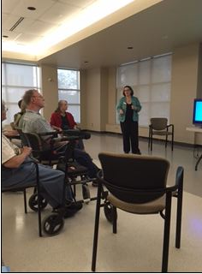

Safety – Shane Quinn
CPCs Closures
Home Safety
Events
  Community Safety - June 4
  Elder Abuse - May 6
Fraud, Scams, Car Thefts & Break-ins
  OPS Fishing Derby By Credit Card
  Donate to Leukemia
  Microsoft Will Fix Your PC
  You Won a Free Room at the Marriott/Hilton!
  Is That CRA Calling? Maybe OPS?

Slide 39
CHNA
Agenda
7:00 pm Introduction - Karen Wright, President CHNA
7:10 pm Special Guest – Karen Secord, Coordinator, Parkdale Food Centre
7:25 pm Key Reports:
  Planning and Development – Kathy Kennedy
  History and Heritage – Andy Billingsley
  Traffic – Luanne Calcutt
  Safety - Shane Quinn, Safety Chair
  Membership- Shelley Mullins
  Communications- Alyson Queen
  Constitution – Peter Eady
  Treasury– Julie Westall
8:40 pm Councillor Chat/Q&A - Jeff Leiper
9:00 pm Adjournment

Slide 40
Membership/Fundraising – Shelley Mullins
Our Neighbourhood Association is only as strong as its membership so we encourage the involvement of all residents in our community.
With a vibrant membership we can:
Promote the general interests and well-beings of our residents
Act as a community spokesperson in promoting and protecting the interests of the community with respect to planning and future development
Support programs that provide safety for community residents – i.e. traffic, crime
Promote and foster community spirit and historical appreciation
Have a stronger voice at City Hall

Slide 41
Membership/Fundraising
Membership in the CHNA is available to all residents of the Civic Hospital neighbourhood – Queensway (N) Carling (S) O-Train (E) Island Park (W)
Starting in 2016, $10 annual memberships will be valid for the current calendar year.
Street representatives will be recruited to spearhead a door-to-door membership campaign in the Fall of 2015 for the 2016 year. Volunteers needed!!
Your 2016 membership card will also get you discounts/specials at participating local businesses.
Membership fees help offset the costs incurred by the CHNA – printing, mailing, rental space for meetings, web hosting, hiring planners and lawyers when contesting planning issues at the OMB, etc.

Slide 42
Membership/Fundraising
Why become a member?
To have a voice in the issues that matter most to you – traffic, safety, crime, community development – your membership provides you a forum to present and discuss your ideas.
To stay up-to-date on neighbourhood events and issues.
To be eligible to vote at the CHNA meetings and run for a board position.

Slide 43
CHNA
Agenda
7:00 pm Introduction - Karen Wright, President CHNA
7:10 pm Special Guest – Karen Secord, Coordinator, Parkdale Food Centre
7:25 pm Key Reports:
  Planning and Development – Kathy Kennedy
  History and Heritage – Andy Billingsley
  Traffic – Luanne Calcutt
  Safety - Shane Quinn, Safety Chair
  Membership- Shelley Mullins
  Communications- Alyson Queen
  Constitution – Peter Eady
  Treasury– Julie Westall
8:40 pm Councillor Chat/Q&A - Jeff Leiper
9:00 pm Adjournment

Slide 44
Communications – Alyson Queen
Support Committees with various initiatives
  Examples: Planning Initiatives, Elder Abuse Seminar, CMBs, Election Donations
  Upcoming: Member Drive, Traffic Awareness Plan
Spring 2015 Newsletter delivered to 2000 households
Continuing to target communications efforts
  Media relations
  Growing online presence and reach (website, Facebook, Twitter)

Slide 45
CHNA
Agenda
7:00 pm Introduction - Karen Wright, President CHNA
7:10 pm Special Guest – Karen Secord, Coordinator, Parkdale Food Centre
7:25 pm Key Reports:
  Planning and Development – Kathy Kennedy
  History and Heritage – Andy Billingsley
  Traffic – Luanne Calcutt
  Safety - Shane Quinn, Safety Chair
  Membership- Shelley Mullins
  Communications- Alyson Queen
  Constitution – Peter Eady
  Treasury– Julie Westall
8:40 pm Councillor Chat/Q&A - Jeff Leiper
9:00 pm Adjournment

Slide 46
Constitution – Peter Eady

Slide 47
CHNA
Agenda
7:00 pm Introduction - Karen Wright, President CHNA
7:10 pm Special Guest – Karen Secord, Coordinator, Parkdale Food Centre
7:25 pm Key Reports:
  Planning and Development – Kathy Kennedy
  History and Heritage – Andy Billingsley
  Traffic – Luanne Calcutt
  Safety - Shane Quinn, Safety Chair
  Membership- Shelley Mullins
  Communications- Alyson Queen
  Constitution – Peter Eady
  Treasury– Julie Westall
8:40 pm Councillor Chat/Q&A - Jeff Leiper
9:00 pm Adjournment

Slide 48
Treasurer Report – Julie Westall
2014
$1529.79 Revenue (membership, donations, cash sponsorships, bake sale)
$4015.90 Expenses (events, function rentals, membership dues, webhosting, Ruskin lot, signage etc.)
Ending balance $4537.27

Slide 49
Treasurer Report – Julie Westall
2015
$348.20 Revenue (membership & donations)
$1035.04 Expenses (events, function rentals, membership dues, webhosting, Ruskin lot, signage etc.)
Ending balance $4096.71

Slide 50
CHNA
Agenda
7:00 pm Introduction - Karen Wright, President CHNA
7:10 pm Special Guest – Karen Secord, Coordinator, Parkdale Food Centre
7:25 pm Key Reports:
  Planning and Development – Kathy Kennedy
  History and Heritage – Andy Billingsley
  Traffic – Luanne Calcutt
  Safety - Shane Quinn, Safety Chair
  Membership- Shelley Mullins
  Communications- Alyson Queen
  Constitution – Peter Eady
  Treasury– Julie Westall
8:40 pm Councillor Chat/Q&A - Jeff Leiper
9:00 pm Adjournment

Slide 51
Councillor’s Report – Jeff Leiper

Slide 52
Backup

Slide 53
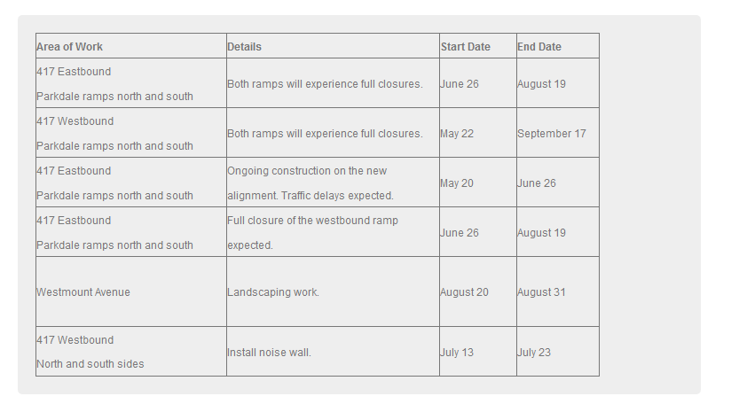
417 @ Parkdale

