Slide 1
Ruskin Park Rezoning
CHNA Public Meeting
Wednesday, August 28, 2013

Slide 2
Welcome
Ruskin Park Sub Committee members
Today
CHNA membership
Petition

Slide 3
AGENDA
History
Today
Rezoning document review including alternatives evaluated
Development Process
CHNA discussions with TOH
Next Steps

Slide 4
Ruskin Park – History
City land since 1936
Used as park until 1958
1965 OMB decision restricts hospital parking to surface lot only
Currently zoned as leisure space (park) with surface lot exemption

Slide 5
Ruskin Park – History
Recurring commitments to return land to use as a local park by both City and Hospital
  1980 Closure to coincide with P1
  1991 Official Plan to close lot by 1996
1996 agreement for 30 year moratorium
  1 year of negotiation with TOH residents mediated by City
  Residents concession allowed for 30 more years of use (ie 1995 – 2025)

Slide 6
30 Year Agreement
“To ensure that the use of the City-owned lands on the north side of the Civic Hospital (bounded by Ruskin, Reid, Hutchison and MacFarlane) which was originally taken over by the City of Ottawa as open space, is limited to a surface parking lot of not more than 270 parking stalls and the adjoining green space, all in existence as of 1995. The lot is primarily for the use of Civic Hospital patients and visitors;
The period of the usage is for not less than 30 years, beginning in 1995. The Hospital will continue to monitor its parking operations and will assess all other options for the supply of parking facilities appropriate to the demands which it faces during this time period. Subsequent to this time period, the use of these lands as a park will be re-evaluated. Area residents, the local community association, the City and the Civic Hospital are to be included as participants in the re-evaluation.”

Slide 7
Change in Direction
February 2012 TOH presented to CAC
  Ruskin option is last choice, other locations preferred.
November 2012. TOH said no change
April 2013 CHNA Spring Meeting
  Councillor report indicated discussions between TOH and City for 45 Ruskin lease and potential development for UOHI requirements.

Slide 8
Where are we now?
June 24th Public Information meeting by TOH
July 9th Finance and Economic Committee reviewed and approved Lease agreement
  $12.2M Construction
  $660,000/yr lease for 15yrs+3x5
  $4.8M (2/3rd) forgiven to pay for capital costs (40% of construction costs)
July 17 Final approval by City Council
July 29 Rezoning application submitted

Slide 9
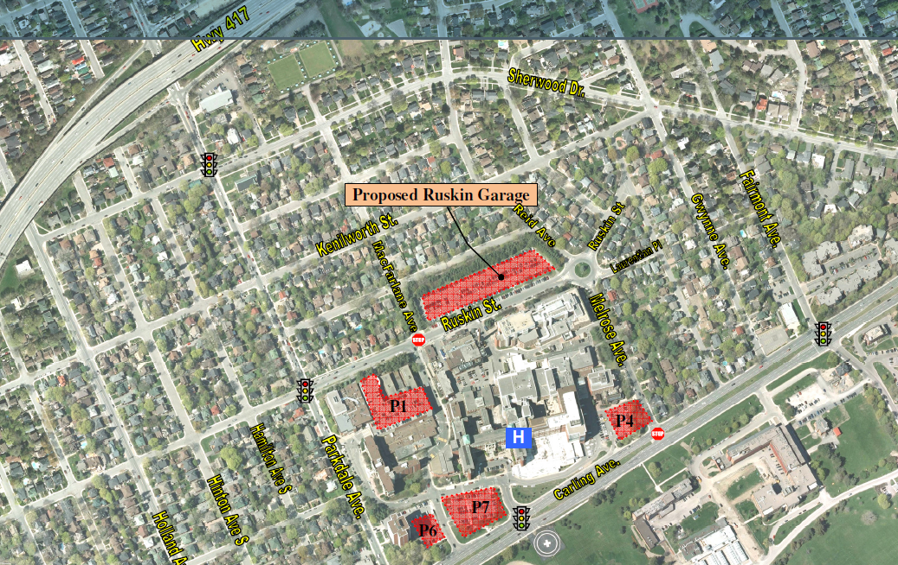
What the documents say.

Slide 10
CHNA Approach
Evaluation and input to zoning application
Discussions with TOH to gather more information and to propose alternative options.
Requests for all related documents via ATIP from City and TOH
Pursuing legal opinion regarding 30 year agreement
Work with our councillor to gain support
Prepare for Site Plan Review
Prepare for potential OMB case

Slide 11
What the documents say
Requirement
TOH Public Statement. Expanded parking required for UOHI expansion and location critical to for elderly/infirm UOHI patients and visitors
The reports + TOH Confirm. Parking increase of 466 stalls is primarily for non UOHI patients, visitors as well as staff
  Note: Location isn’t convenient to patients and visitors to the rest of hospital

Slide 12
What the documents say
Public Parking
Estimated Future Demand for Public Stalls: 325-to-350 stalls
  Existing Latent Demand (Circulation) – 220 stalls
  Additional TOH Clinic Visits: 20-to-25 stalls
  UOHI Expanded Facilities: 60-to-70 stalls
  Additional Visitors: 10-to-15 stalls
  Additional Public Business Visits: 5-to-10 stalls
Employee Parking
Estimated Future Demand for Employee Stalls: 205-to-240 stalls
  Additional TOH Employees: 5-to-10 stalls
  UOHI Expanded Facilities Employees: 85-to-115 stalls
  1% Growth in 1,463 stalls made available to employees: 115 stalls

Slide 13
What the documents say.
Alternatives
Front of Hospital off Carling
  Maintain appearance from Carling to “encourage an attractive community”
  Existing parking footprints too small. No single lot can provide same number of spots

Slide 14
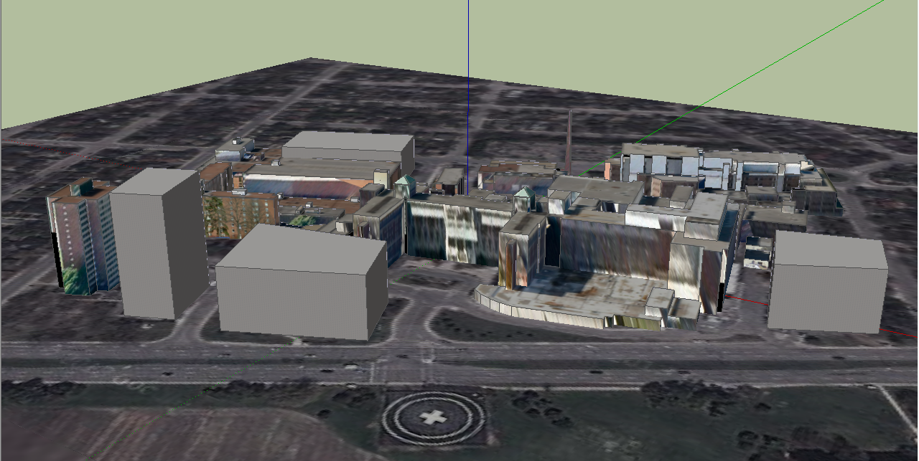
Locations considered for a new garage.
P1 - 6½ levels above &
2½ belowground
P6
15 levels
P7
8 levels
P4
8 levels
What is the number of levels required to accommodate 466 stalls? (Illustration ignores height and setback restrictions and does not depict a 736 stall capacity )

Slide 15
What the documents say.
Alternatives
Front of Hospital off Carling (continued)
  Combination of P4, P6 and P7 355 spots only using current footprint
  Underground is too $$
  Carling is too busy and cars may divert to Ruskin/Melrose and increase local traffic
  “Stacking space” insufficient assuming no change of parking access
  Preserve front of campus for remote possibility they require for clinical growth

Slide 16
Locations considered for a new garage.
P1 - 6½ levels above &
2½ belowground
P6
15 levels
P7
8 levels
P4
8 levels
What is the number of levels required to accommodate 466 stalls? (Illustration ignores height and setback restrictions and does not depict a 736 stall capacity )

Slide 17
What the documents say.
Alternatives
Expand and rebuild part of P1 Garage
  Cost – 2x Ruskin
  Size – 700 additional spots versus 466
  Smaller, less costly option not evaluated
  Exit on Parkdale requires a WB-RT auxiliary lane fronting several residences
  No evaluation of routing traffic to front of campus to either of 2 Carling Avenue exits

Slide 18
What the documents say.
Why I2 zoning?
  Major Institutional zoning requested vs modified exception to current zoning.
  Question: Why would you do this if you intend to return it to a park some day?
  Arterial Access Required: “The purpose of the I2-Major Institutional Zone is to: 2) ensure that these large scale, high traffic generating institutions locate only on large parcels of land, with direct access to an arterial road and near rapid transit stations;
  But, Ruskin is NOT on an arterial road

Slide 19
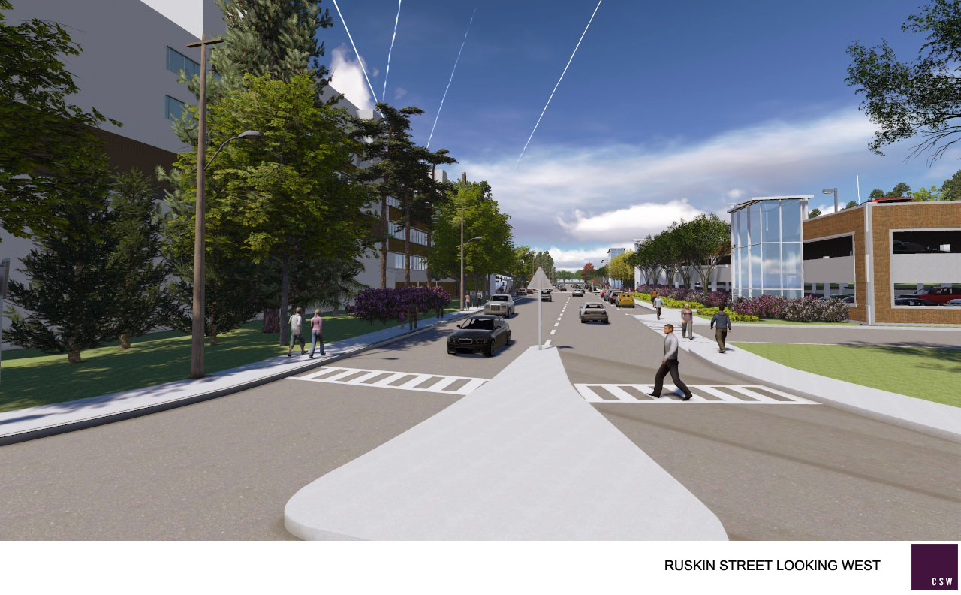
What would the proposed parking facility look like?

Slide 20
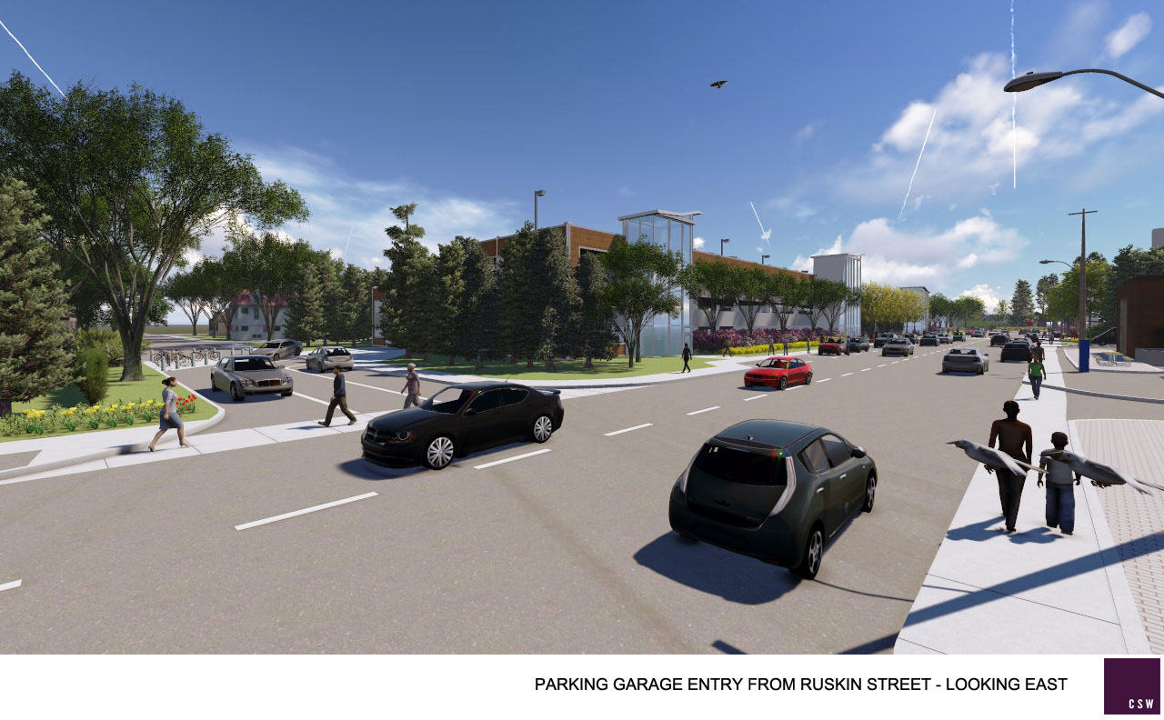
What would the proposed parking facility look like?

Slide 21
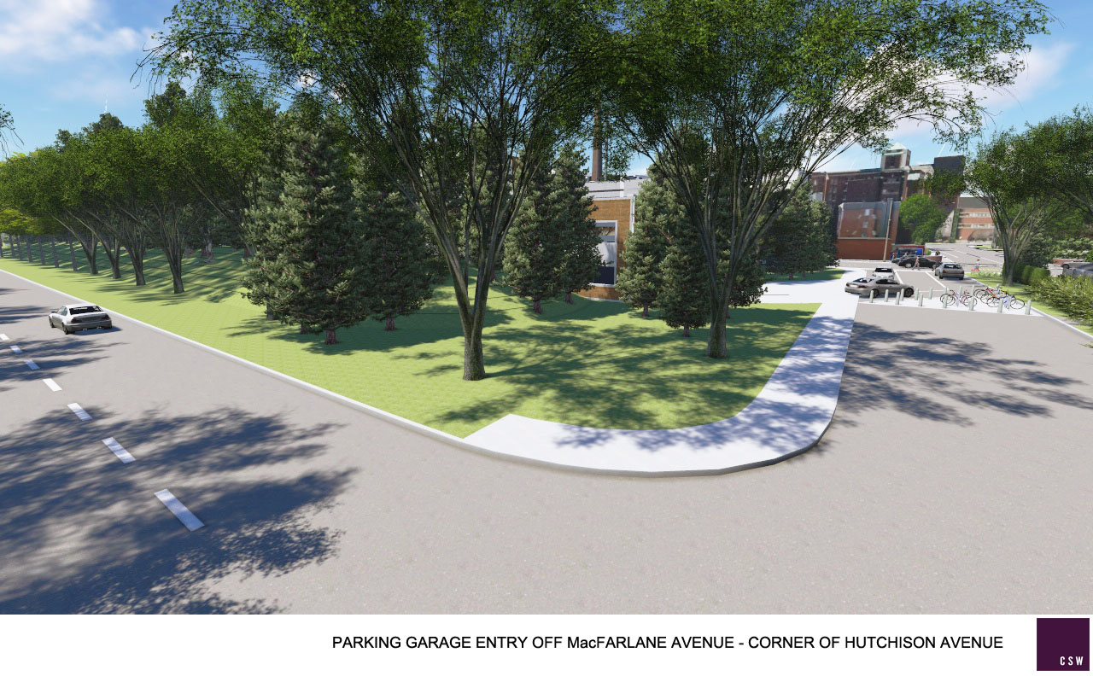
What would the proposed parking facility look like?

Slide 22
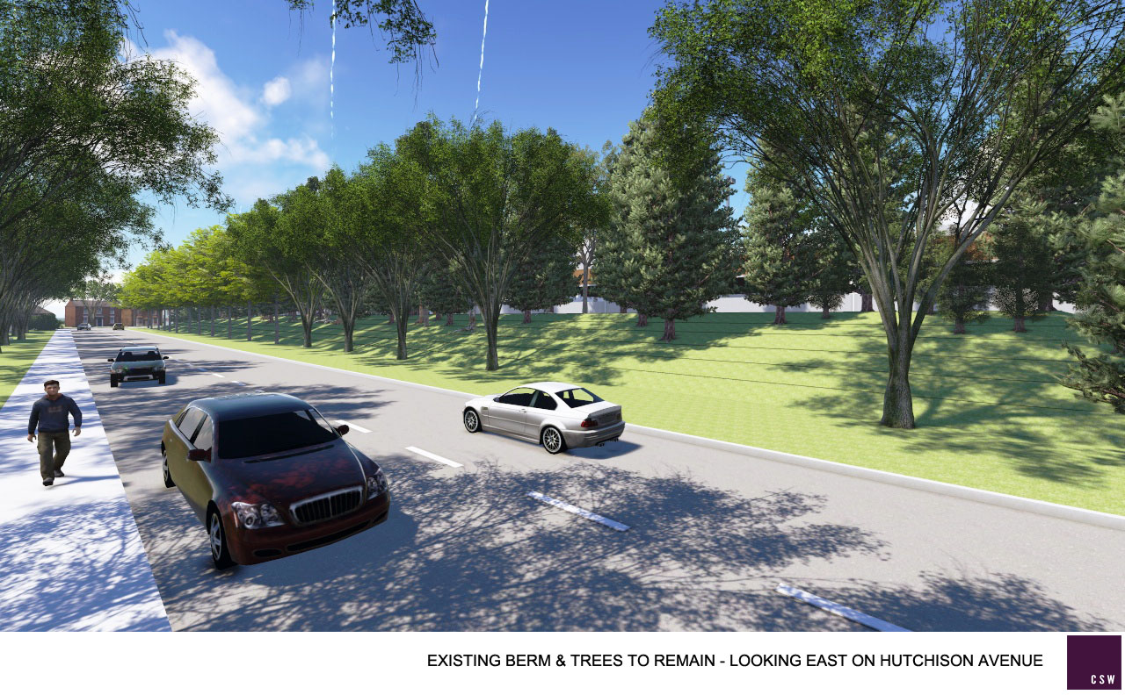
What would the proposed parking facility look like?

Slide 23
What the documents and TOH say.
Parking Structure
  Current tree berm to be maintained on 2 of 3 sides to shield residents from building, lights, noise, air pollution.
  Lights provided on all floors for safety
  Impractical verbal promise of no access to top floor after dark to avoid night lighting on rooftop parking.
  No discussion of early morning snow removal
  No discussion of any increased safety issues/criminal elements.

Slide 24
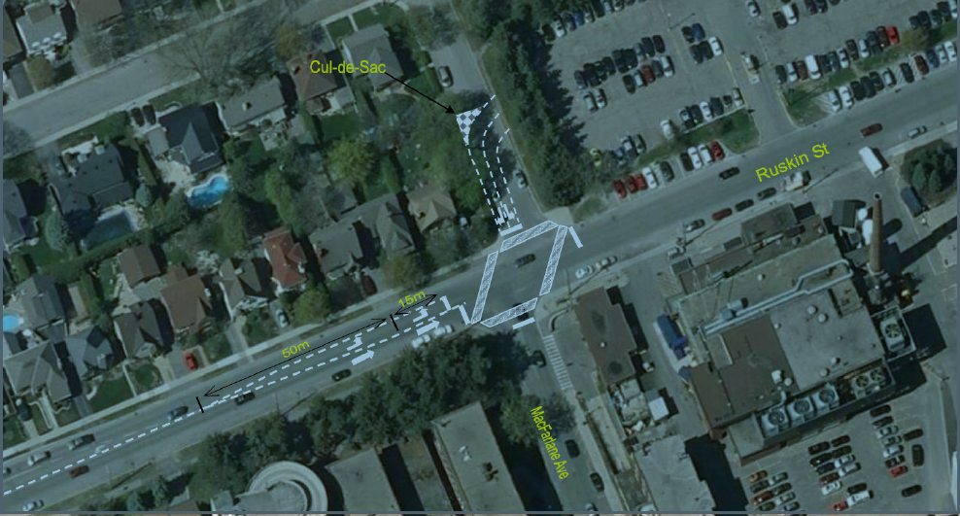
Traffic Flow

Slide 25
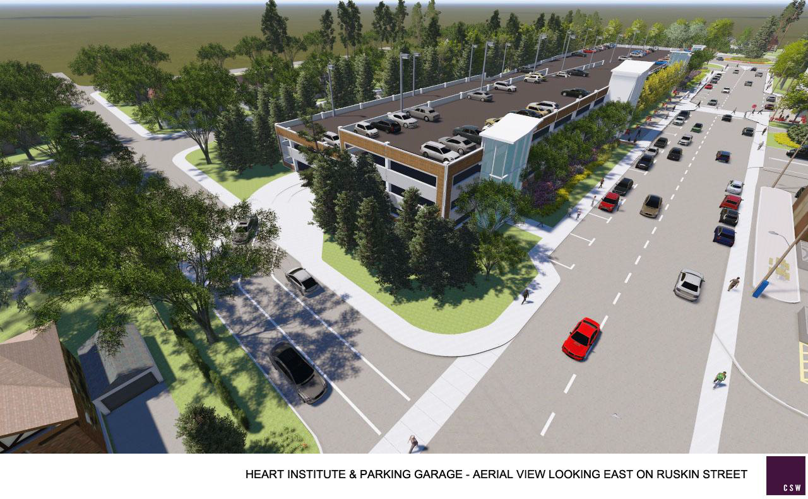
Traffic Flow

Slide 26
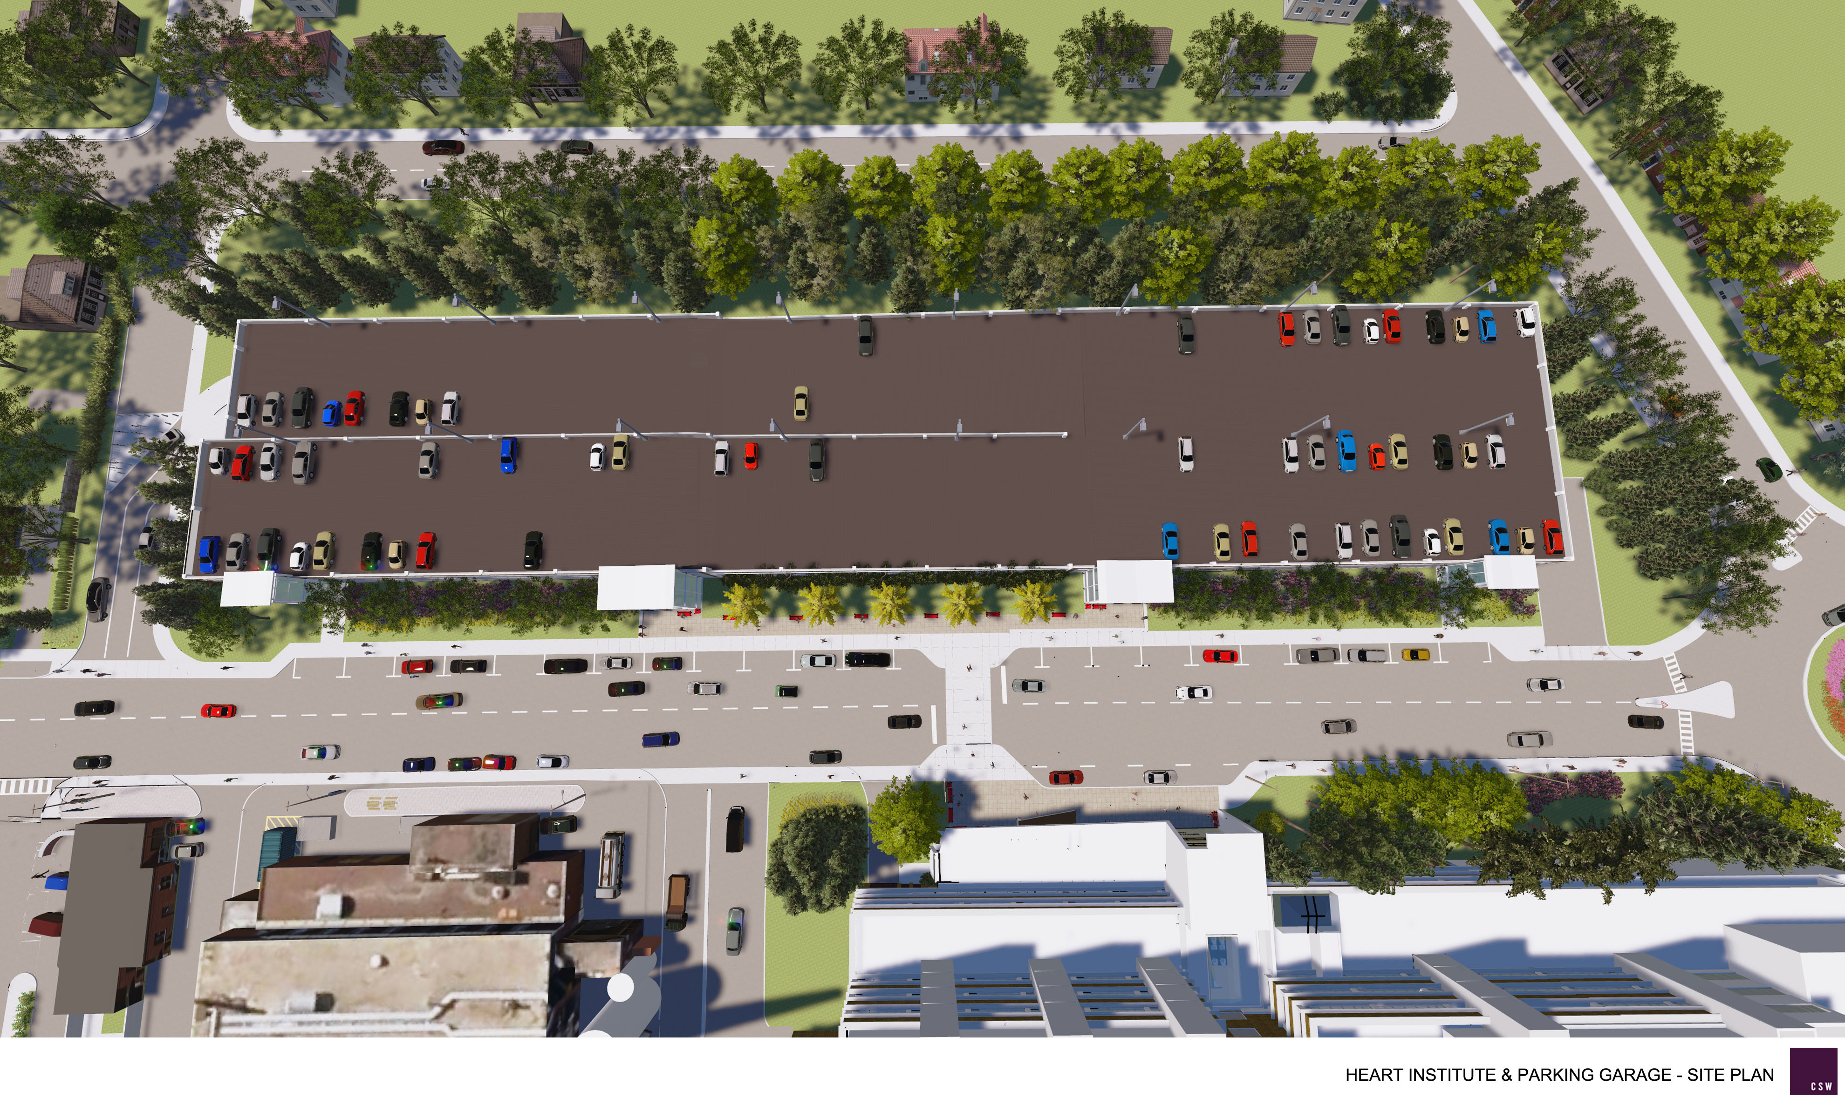
Traffic Flow

Slide 27
What the documents say.
Traffic Study
70-80% of cars will access via Ruskin/Parkdale intersection
20% will access via Ruskin East (Melrose etc)
Estimated Volume at Parkdale/Ruskin intersection
  Future southbound am peak graded D
    .82% Volume to Capacity (V/C)
    .90% V/C considered F and unsatisfactory
  Note: error on table 10-2 chart flipping B and D

Slide 28
What the documents say.
Traffic Study
Ruskin must be redesigned to handle larger volume
Have not assessed capacity Sherwood intersection
Have not assessed impact to Queensway off ramps
Carling compared to Parkdale numbers show Parkdale lanes have 3x traffic at peak today.
  576vph southbound am from Parkdale from 417 in AM
  233vph eastbound am on Carling (or 700vph 3 lane) in AM
Access bylaws restrict development off Carling but support access on residential streets.

Slide 29
TOH Plan By the Numbers
Current ground lot
New parking garage
    270 parking spots
    UOHI patients and visitors only
    UOHI primarily 9-5 Monday to Friday
    Currently 70-90% utilized a.m. and 50-70% utilized p.m.
    Convenient to UOHI
  725 parking spots; 466 net new
  All TOH visitors, patients and staff
  TOH 24/7 and 365
  UOHI = 60-70 new spots needed for patients/visitors (15% of increased spots)
  Location inconvenient to majority of new users (ie 396 of 466 are non UOHI)

Slide 30
TOH plan for 45 Ruskin - Inconsistencies
TOH public statements to date
Consultants report statements
For UOHI expansion
Carling is too busy for parking garage
On campus options not feasible
Temporary Structure
For all staff, visitors, patients
Parkdale and Ruskin are 3x busier than Carling yet are the preferred access
Larger or combined footprint not properly considered
No mention of temporary nor any requirement for TOH or City to tear down at end of lease.

Slide 31
Report Evaluation Summary
Traffic volume on Ruskin
  Already more than Carling (233vph/lane EB vs 381 EB increasing to 490 in AM)
Traffic volume on Parkdale
  Already more than Carling (233VPH EB/Lane AM vs 576vph SB increasing to 672 vph in AM )
Better alternatives need to be evaluated
  UOHI expansion doesn’t drive large lot on Ruskin
  P1 and Front are more convenient to TOH users, the bulk of the need
  P1 and Front can be accessed via Carling
  Concerns regarding emergency access and vehicle storage can be addressed by proper location of parking lot entry/exit
  Alternatives meet needs and are affordable (scaled back P1 option, larger/combined Carling lots)
Building impact to local streets (rooftop lights, noise, security, trees)

Slide 32
Discussion with TOH
First meeting, August 21, 2013
Follow up
Next meeting September 09, 2013

Slide 33
Discussion with TOH
Options:
  Supplement parking with paid street parking during the day
  P1 smaller expansion with access via Carling not Parkdale
  P6/7 expansion with access via Carling
    Include entrance and design that address emergency access and “stacking”. Provide improved signage

Slide 34
Development Process
Deadlines
  Public Comments – ongoing
    Sept 10, 2013
    Mid October
Public Meeting with Councillor Hobbs
    Fall 2013
Planning and Development Committee
    November 22, 2013 (TBC)
OMB

Slide 35
What You Can Do
Information/Slides
  www.chnaottawa.ca
  www.facebook.com/CHNARuskinPark
  Email vp@chnaottawa.ca
Read the zoning application documents
  http://app01.ottawa.ca/postingplans/appDetails.jsf?lang=en&appId=__9TKYBC

Slide 36
What You Can Do
Send your comments to douglas.james@ottawa.ca and note the application number #D02-02-13-0068 45 Ruskin St
Comments should be fact based and bring to his attention concerns based on inconsistencies with data, interpretation of data in the reports, or points and alternatives not included in the application submission.
Provide the City and CHNA your ideas for alternative workable solutions to this problem. We know parking is needed but the where and how needs to make sense for the community.

Slide 37
What You Can Do
  Email Councillor Hobbs Katherine.Hobbs@ottawa.ca
  Sign Petition
  Membership Registration
  Donations for ATIP, legal, OMB

