Slide 1
Civic Hospital Neighbourhood Association Spring Information Meeting
May 07, 2019
www.chnaottawa.ca

Slide 2
CHNA Spring Information Meeting Agenda
7:00 pm Review of Agenda and General Remarks: Karen Wright, President CHNA
7:05 pm CHNA Spring Report – Events, Park Projects, Environment Survey, OUHI expansion
7:35 pm Transportation Matters– Luanne Calcutt
7:45 pm Transportation Master Plan refresh and Kitchissippi Update : Councillor Leiper
8:10 pm Planning and Development – Kathy Kennedy
8:15 pm Membership
8:20 pm Honouring Keith Hobbs
8:25 pm Join the Team
8:30 pm Light Refreshments, Networking
8:45 pm Adjournment

Slide 3
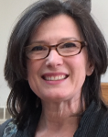
2019 Spring Update – Karen Wright, CHNA President

Slide 4
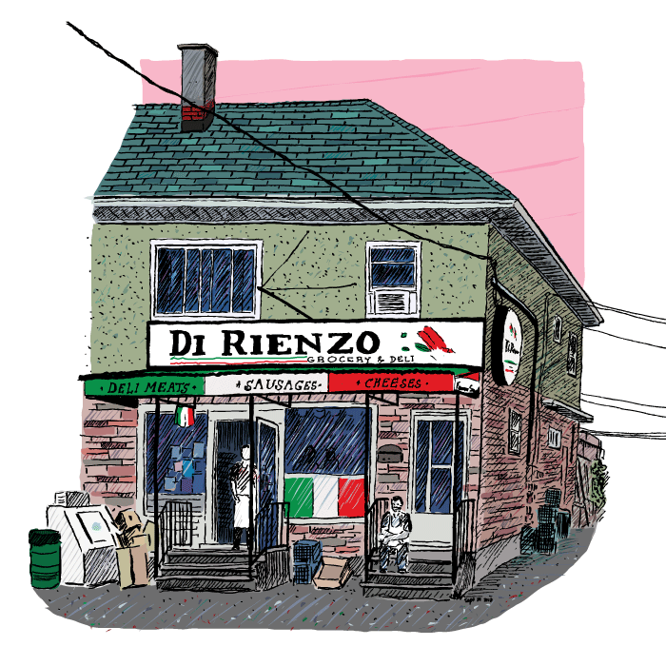
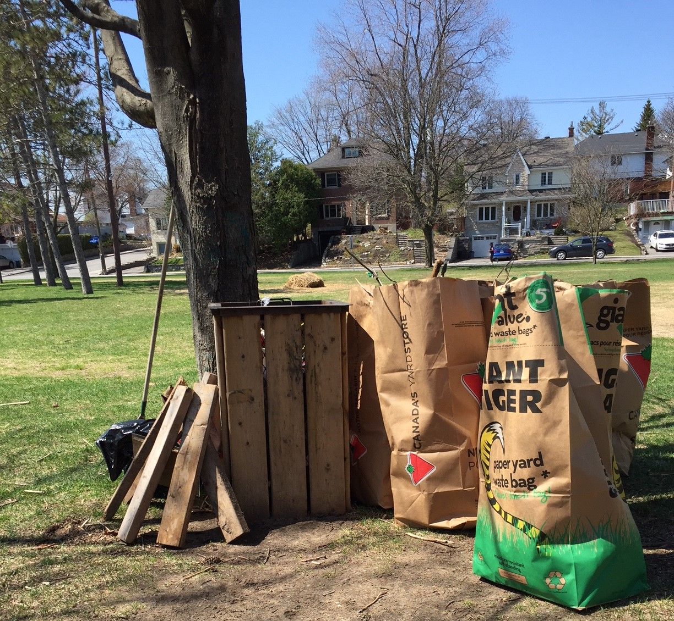
Park Clean – May 11th 10am-12pm

Slide 5
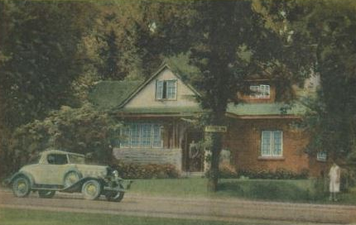
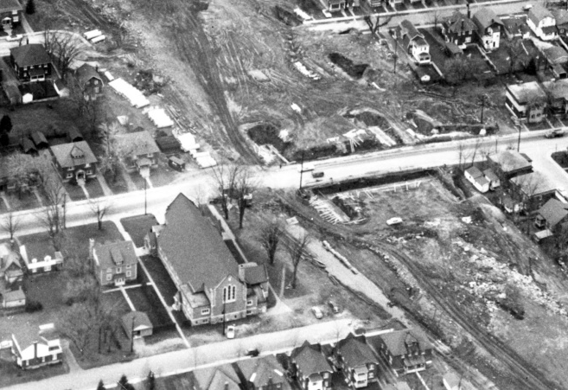
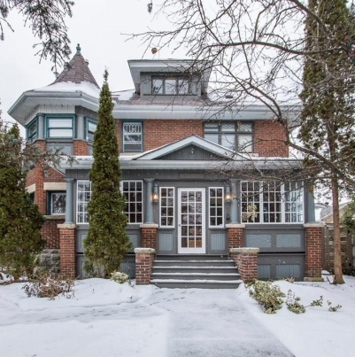
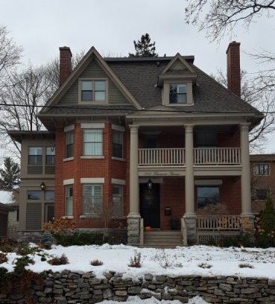
Parkdale and Fairmont Avenues: A Visual History of the People and Properties
Did you know Parkdale once had a Tea House/Inn?
There used to be a factory on Parkdale that made vacuums
When the railway became Hwy 417, how did this affect our neighbourhood around Parkdale?
Who once lived in these
100 year-old homes on Fairmont?
May 16th - 7 PM St Stephen’s Church (579 Parkdale)

Slide 6
4th Annual Community Garage Sale
Alert info@chnaottawa.ca you’re participating, and we’ll put you on the map

Slide 7
Champlain Park, Civic Hospital, Hampton Iona, Hintonburg, Island Park, Mechanicsville, Wellington Village, Westboro, Westboro Beach

Slide 9
All Candidates – Sept. 25th
Federal Election Candidates
Co-Sponsor with:
Centretown Citizens Community Association, Dalhousie Community Association, Dow’s Lake Residents’ Association, Glebe Community Association, Glebe Annex Community Association, Hintonburg Community Association, Mechanicsville Community Association, Old Ottawa South Community Association, Old Ottawa East Community Association, Westboro Community Association.

Slide 10
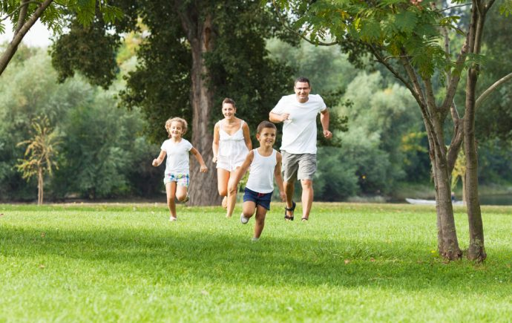
Reid Park
Back to work – May 13
Reopening –Approx June 17
Wading Pool – June 27 – Aug 22
Re-Opening Event! - June

Slide 11
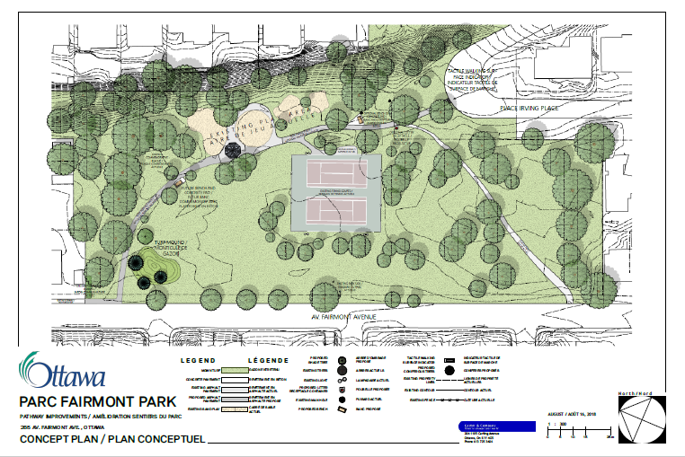
Fairmont Park - Pathway Improvement

Slide 12
Environment Committee
CHNA joined 19 other CA’s and called on the City of Ottawa to declare a climate emergency and make climate action an official Term of Council priority for the 2018-22 Term of Council.

Slide 13
2 Minute Environment Survey
Lots of BIG environmental issues , so what can WE do?
Please take 2 mins to help CHNA’s environment committee focus on local projects that matter to you
https://www.surveymonkey.com/r/H69X8WZ

Slide 14
Update on Heart Institute
- Life Support Capital Project
Partial lobby opened on April 30th
Imaging Centre opening at the end of June
Completion and opening of full lobby early
January 2020
Old ambulance entrance to reopen in
January 2020

Slide 15
Graphic rendering of front lobby
This section is completed and opened to the public.

Slide 16
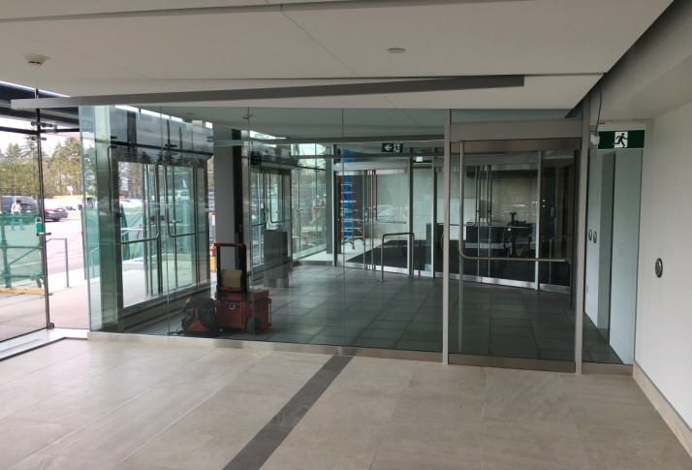
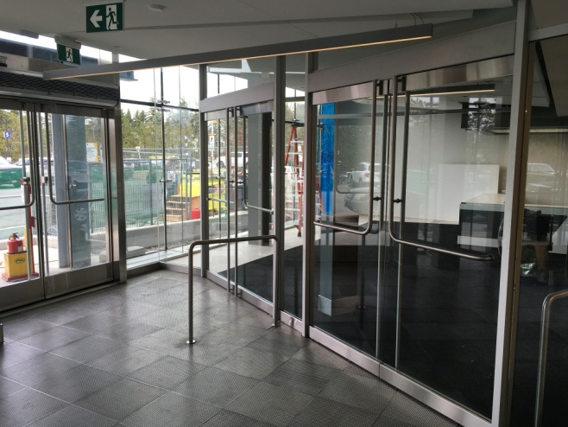
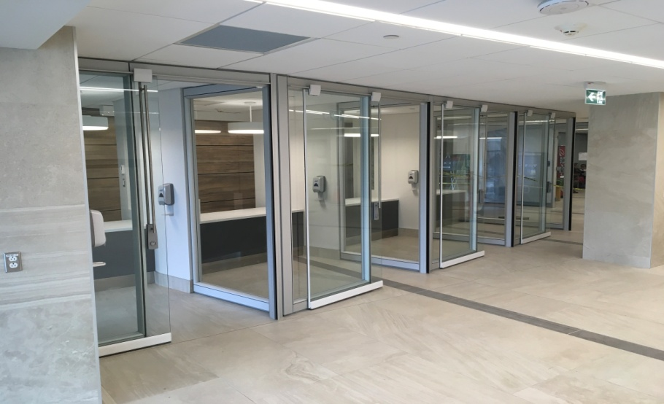
New lobby (partially opened)
New Tickers
seating area
Double doors
Central registration

Slide 17
This section is being completed.

Slide 18
Graphic rendering of the section being completed
Notes:
The construction work will be outside until end of October after this it will move inside. The crew will shrink most likely starting October. No other impacts on residents.

Slide 19
Grand opening – January 2020!

Slide 20
Transportation Committee Luanne Calcutt
2013 Transportation Master Plan (TMP) is a supporting document to the City’s Official Plan
Blueprint for planning, developing and operating city’s walking, cycling, transit and road networks over next 2 decades (to 2031)
Builds on 2003 and 2008 TMPs

Slide 21
Transportation Committee Luanne Calcutt
Key Theme
Safe and efficient transportation infrastructure
– The Plan puts emphasis on road safety for all users, transportation system management tools that maximize people moving rather than vehicle-moving capacity to make better use of transportation infrastructure, and parking management

Slide 22
Transportation Committee Luanne Calcutt
Request that changes to the TMP:
Reduce, not increase, traffic on Parkdale, Holland, Sherwood
Leverage Carling Avenue for use by current 417 traffic
Do not revisit the use of Parkdale for truck traffic

Slide 23
Transportation Committee Luanne Calcutt
The CHNA continues to be represented at the CEG where discussions regarding future traffic and transportation priorities have been identified.
Additionally, the CHNA is working with TOH to identify opportunities to address current traffic problems.

Slide 24
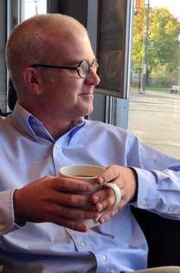
Transportation Master Plan & Kitchissippi Update Councillor Jeff Leiper

Slide 25
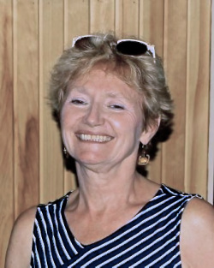
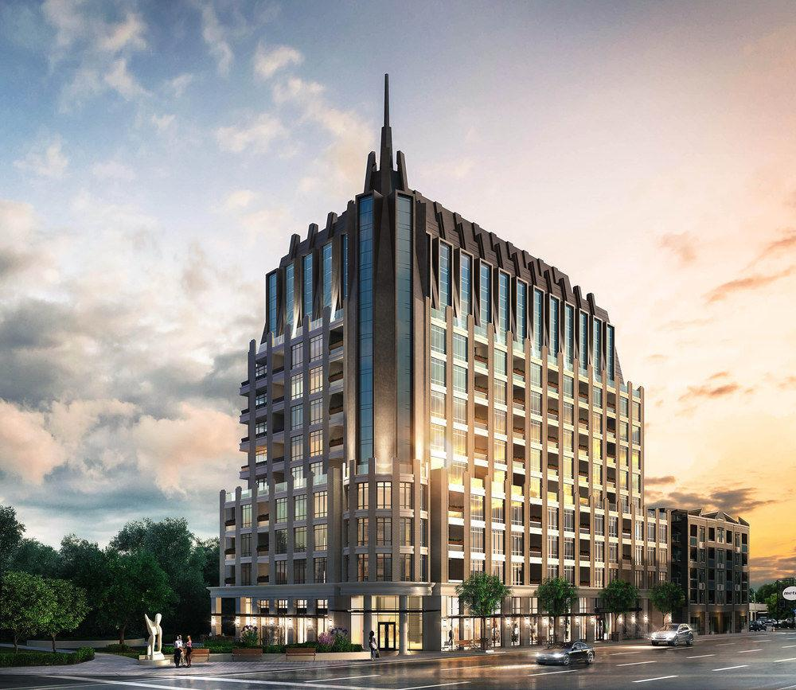
Planning and Development Kathy Kennedy
16-20 Champagne
270 Breezehill
211 Loretta
90 Champagne
OMB/LPAT

Slide 26
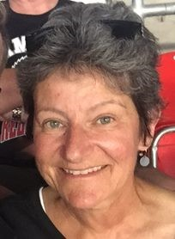
Membership Rhonda Birenbaum
NEW: Lifetime Membership $100
Never have to worry about remembering to renew!

Slide 27
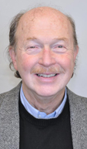
Honouring Keith Hobbs

Slide 28
CHNA Volunteer Award
Recognize residents who have contributed to the liveability of our neighbourhood and the well-being of fellow residents.
Youth and Adult category
Nominations for 2019 now being received

Slide 29
Join the Team
Communications
Secretary
Subcomittee Roles
Fundraising
Special Events
Join a Committee

Slide 30
Refreshments and Networking

Slide 31
Adjourment

